Slide 1

Nau mai, haere mai, Welcome
AUT Perioperative Practice Students
ki te Hamilton Kirikiriroa!

Slide 2

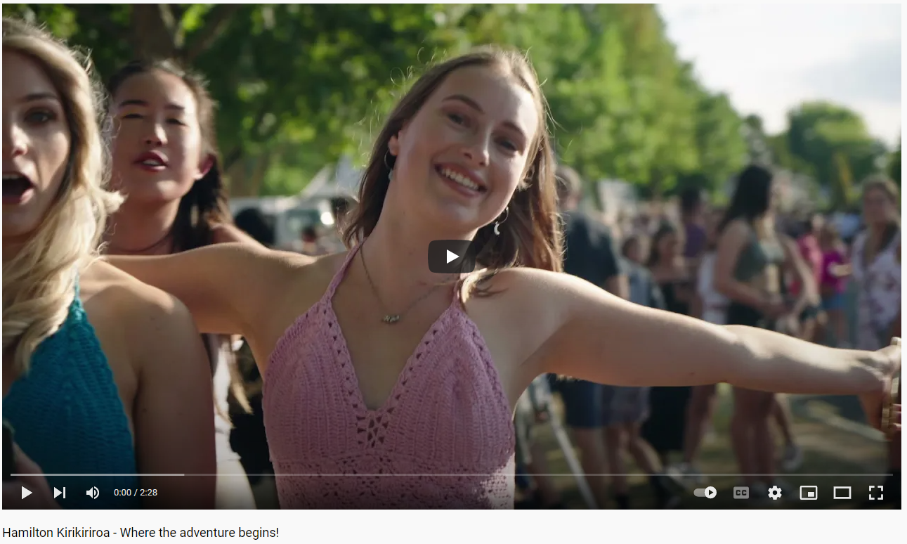
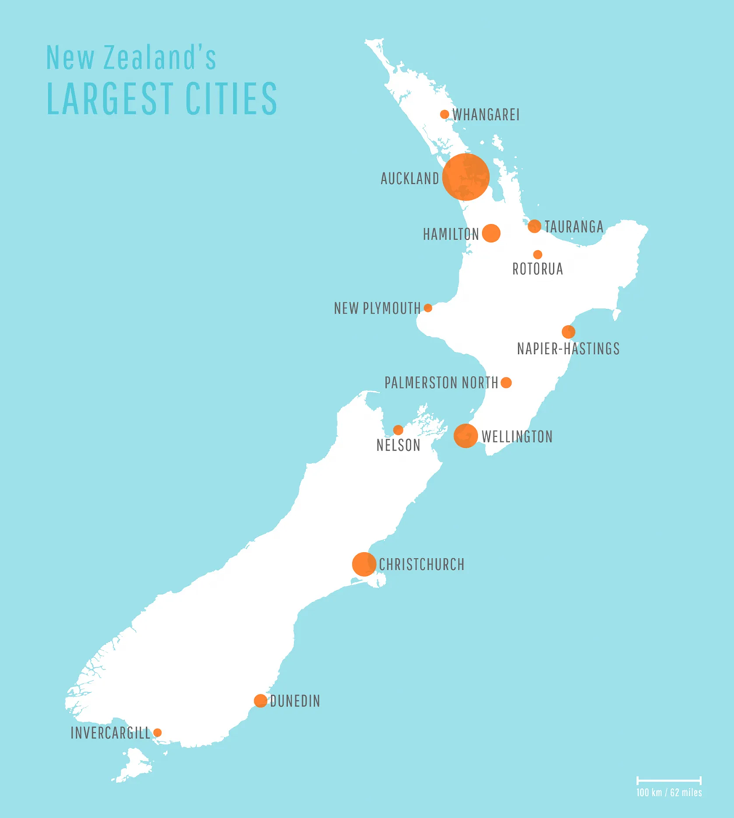
Why choose Hamilton?
Click here to learn more about Hamilton (2:28min)

Slide 3
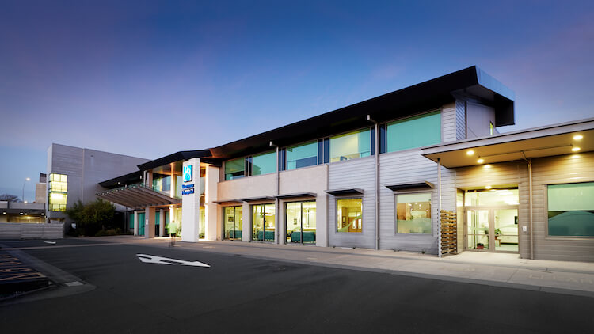
Why choose Braemar Hospital?
Braemar has nine operating theatres, two endoscopy suites and a five bed Special Care Unit (ICU/HDU) supporting a full range of surgical specialties – and we’re growing!
A placement at Braemar will mean you have sophisticated facilities and equipment at your fingertips.
We also take a genuine interest in supporting you with your growth and development.
Our Executive Chef and kitchen team provide all of our team with morning and afternoon teas, and subsidised restaurant quality lunches and dinners.
We also take a really keen interest in wellness meaning you will have access to various initiatives and programmes to support your overall health and well-being while you’re with us!

Slide 4
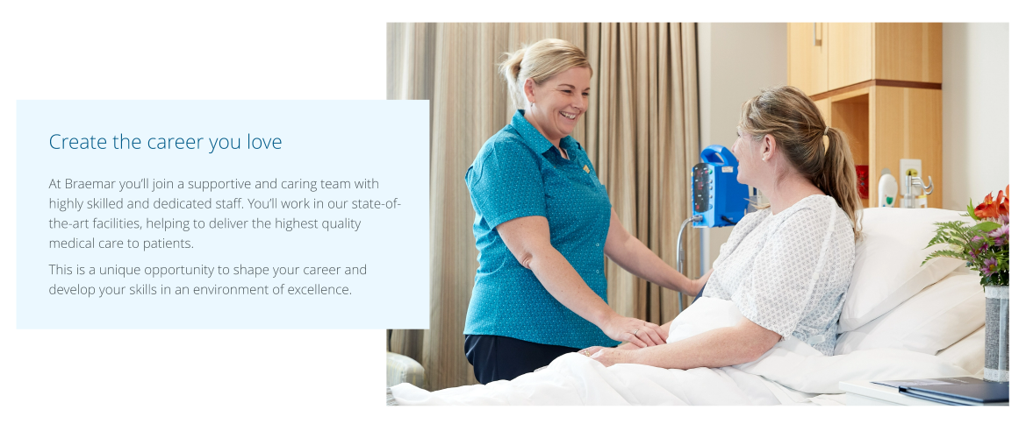

Slide 5
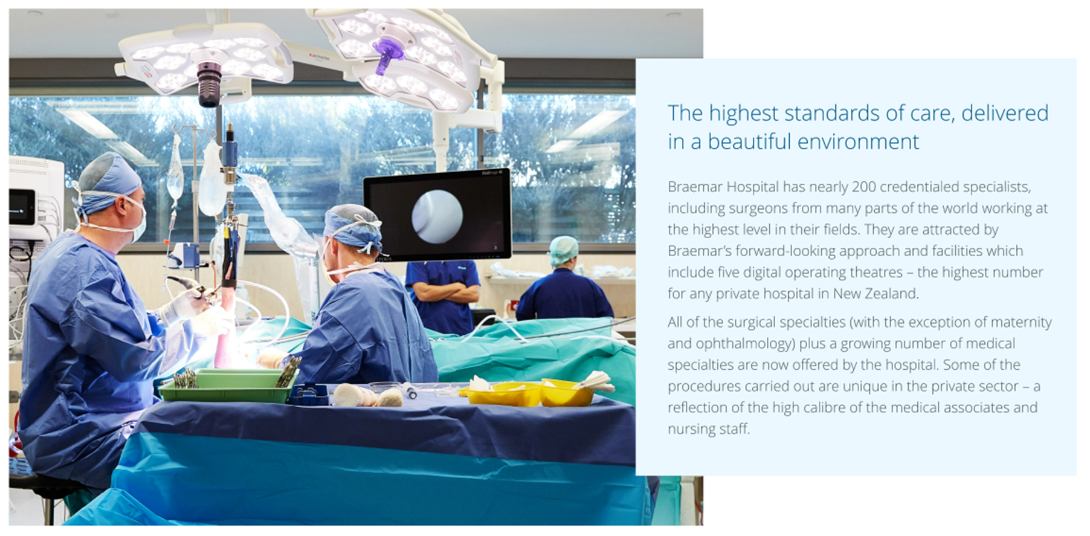

Slide 6
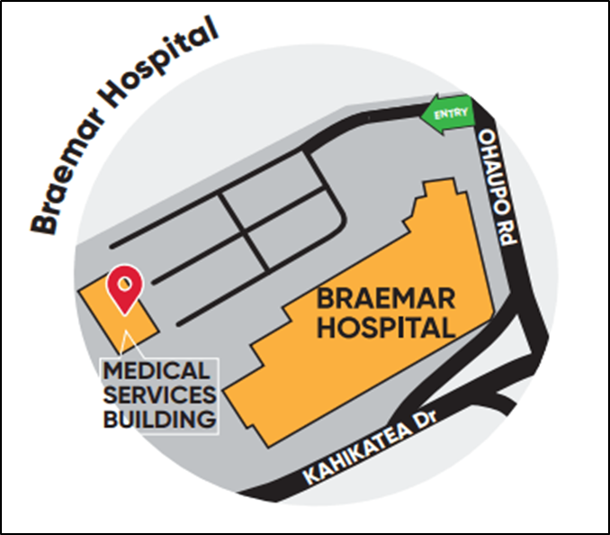
Where are we?
We are located on the corner of Ohaupo Road and Kahikatea Drive, at Hamilton Lake.
We’re within walking distance to Lake Rotorua and the beautiful Hamilton Domain.
It’s 5-minutes drive to Hamilton city centre.
We’re within close proximity to some great cafes and local parks.

Slide 7
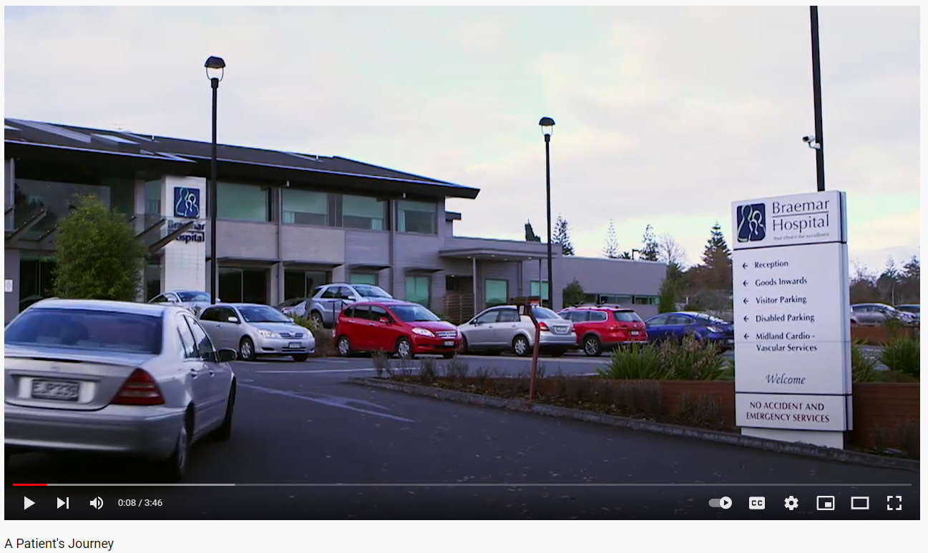
Click here to learn more about Braemar Hospital (3:46 min)

