Slide 1

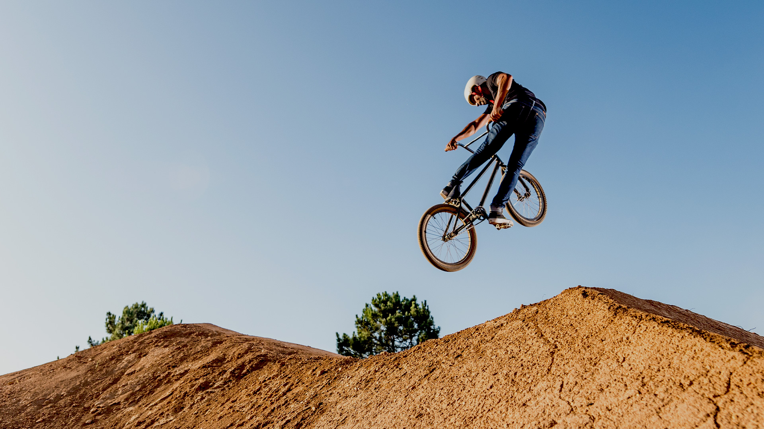


SPORT AND RECREATION
CONTEMPORARY SKILL ACQUISITION WEEK 3
Constraints Led Approach
Dr Sarah-Kate Millar

Slide 2
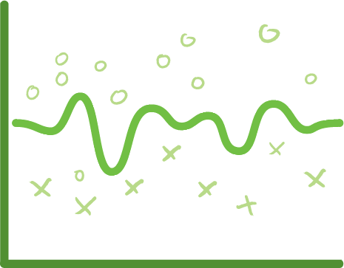

Re-cap key points
Learning is non-linear
The environment shapes action
Perception is tightly coupled to action
Information is not static, it is dynamic
Notes:
Stair walking (VIDEO) . Half class walk out and watch. Repeat. What did you notice? Regular distance. Top of step and where you put your toes to get over the step. What tells you that it needs to be that high?
Floor to top of stair. The gap describes the angle and that controls the hip. We trip most on the bottom and top step because you run out of things to see.(you can’t see the gap)
Boundaries. Door frame. We walk through the centre. What did you notice? Walked through the middle of the doorway. Who stopped and thought about that? How did you know – did you measure it? No – perceive through the boundaries either side.
Locomotor stuff is given for free. Perception and action
Lift the chair. Automatically push your centre of gravity back. Sways back. Change in velocity and shirt in centre of gravity enables you to make a postural correction. But we do this without thinking.

Slide 3
Non-linear systems
(compared to linear)
Cause and effect – non-proportionality
Multi-outcomes – affordances
and specific to the individual
Parametric control – change in parameters guide new learning
Variability – exploration vs ’noise’
Self-organisation from the interaction of multiple constraints

Slide 4



The ENVIRONMENT shapes the movement/action

Slide 5
Constraints (Newell, 1986)
THE PERFORMER (PERSON, ATHLETE):
Physical characteristics, cognitive, psychological and emotional attributes of the individual
THE ENVIRONMENT:
Physical and socio-cultural environment
THE TASK AT HAND
“The task in the here and now finally shapes the movement.”

Slide 6

Performer
Adapted from Karl Newell (1986)
How performance emerges under constraints
Environment
Task
Functional behaviour selected
under constraints

Slide 7
Problem solving from a
Dynamic Systems perspective
An attractor state is a preferred pattern to solve a movement problem
It emerges from interacting constraints
Skill should be looked at from the HOLISTIC viewpoint. ‘Shapes’ that are attainable by the performer will be affected by one or a number of systems.
Notes:
When manipulating the constraints it is important to ensure that are all considered as they interact with each other
An experienced teacher/instructor would consider the outcome or movement goal and know which constraints to manipulate and in what way

Slide 8

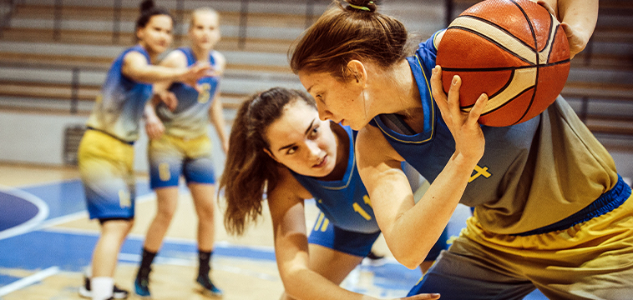
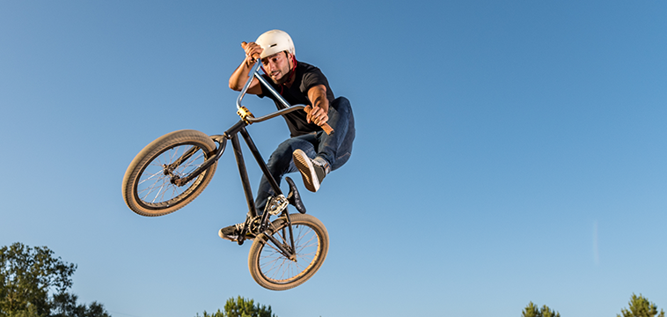
Learning something new is uncomfortable
New behaviours emerge from the constraints that surround them
Plan for the movement goal and the transition required to attain it
Notes:
New coach in soccer club – students been used to playing 11 vs 11 games. You introduce 4 vs 4 games. Too big a challenge, can’t apply any of their existing skills and knowledge, therefore no learning happening.

Slide 9
Transition of method
Traditional | Constraints - led
Drill Teacher-centred Technique? Confidence? | Exploration Learner-centred Games? Confidence?
Notes:
When manipulating the constraints it is important to ensure that are all considered as they interact with each other
An experienced teacher/instructor would consider the outcome or movement goal and know which constraints to manipulate and in what way

Slide 10

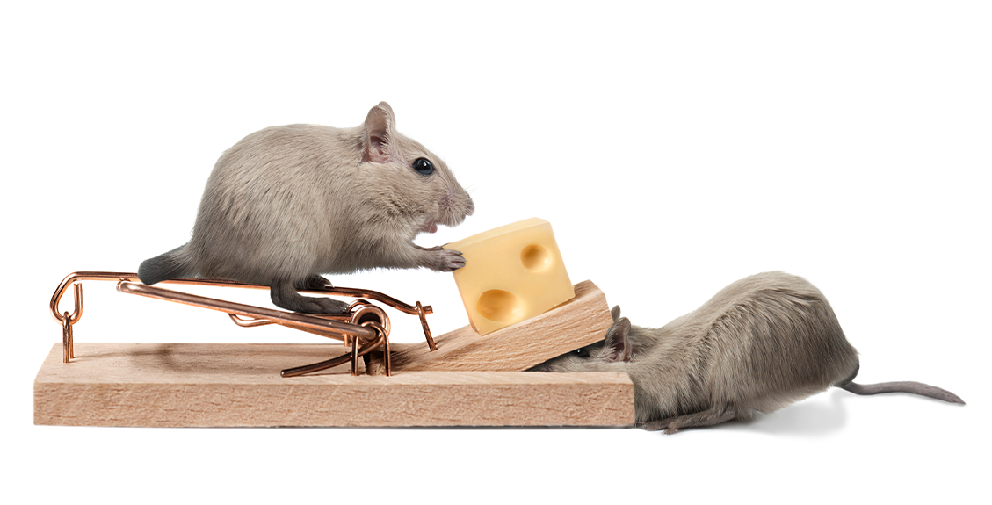
Where to start?
Manipulate the constraints…
It’s about exploration...

Slide 11
Sound familiar...
Modification of the Learning Environment
  Rules, Equipment, Pitch Size, Task…
Use of challenges… to let players solve problems in their own ways…
Use of questions to help guide players to effective solutions… discovery learning
Developing new techniques… allowing for individual solutions
Notes:
Students to think of a challenge for learner/athlete/student to solve

Slide 12
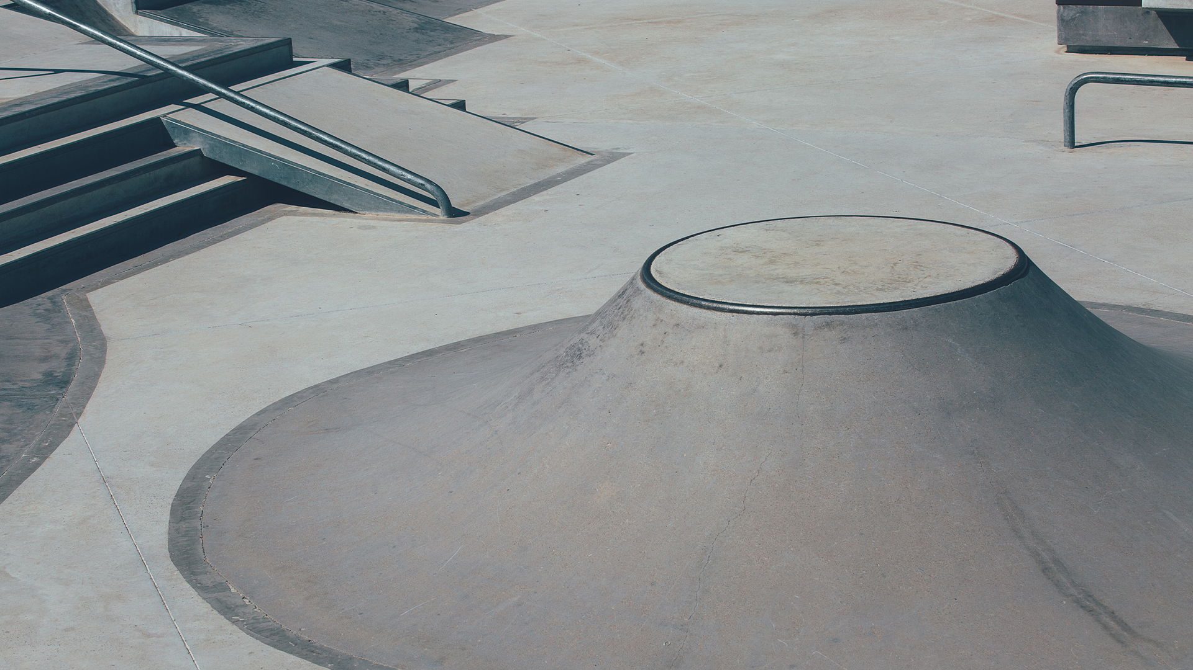
How do we plan for learning then?
Move away from the ‘recipe book’ approach to teaching/coaching
Planning is still important
Needs based and organic
Be patient
Be ready for non-linear changes
Notes:
Grows as the learners grow
Tecahing has to be adaptable to learning situation

Slide 13
For any performers
Allow the players to find solutions (discovery learning)
Adapt the discovery process to the learner
Ask questions that help the players to solve the problems (guided discovery)
Create a culture where mistakes are expected
If you aren’t making mistakes, then you aren’t learning
(John Wooden)

Slide 14
QUESTION
In your own words, why is a constraints-led perspective a HOLISTIC approach to skill development?

Slide 15
And another thing
The perfect answer is within the performer
Your problem is understanding what the goal is and how to shape practice in order to address this
Constrained approaches empower and motivate performers
“My solution” equals more confidence and more motivation

