Slide 1
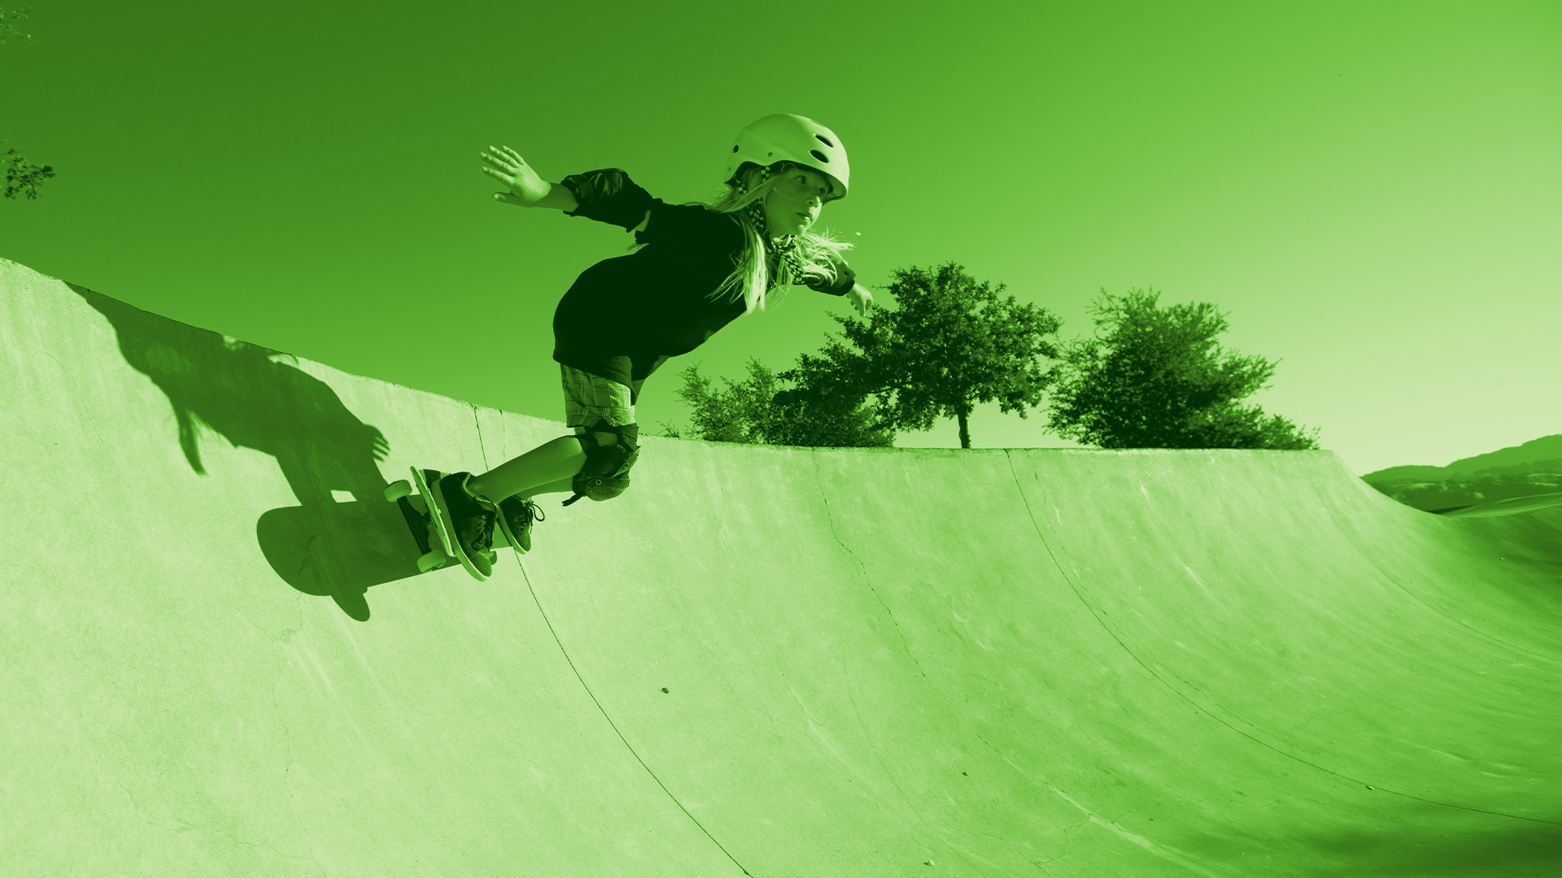
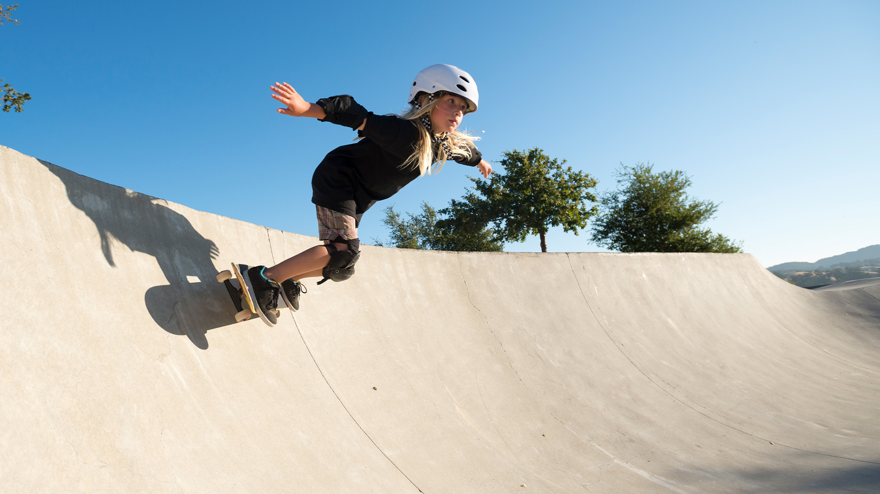
SPORT AND RECREATION
CONTEMPORARY SKILL ACQUISITION WEEK 1
Learning Through Observation
Dr Sarah-Kate Millar

Slide 2
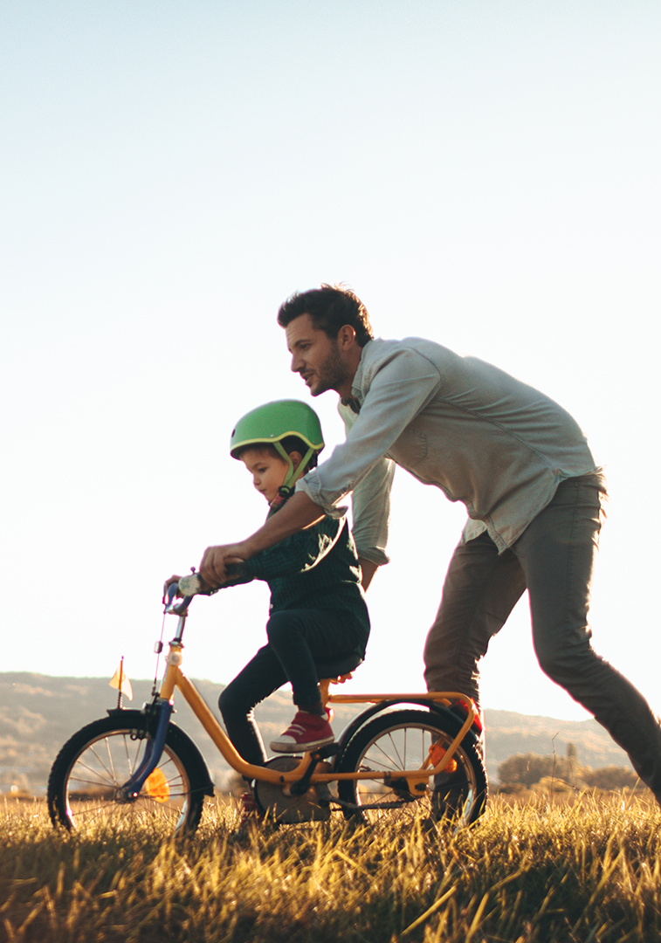
What are the different ways people can learn a skill?
Observational learning
Rewards
Law of effect
Instructions – information processing
Environment

Slide 3
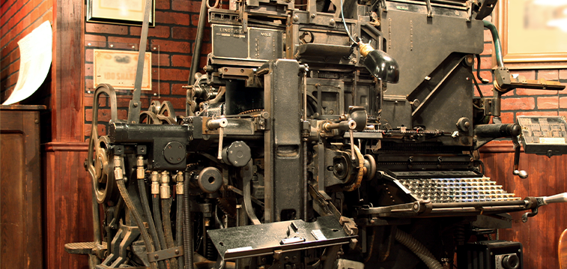
Observational Learning
Caveman
Romans (galley boats)
Middle ages (cultural dance)
Masons
Then came the printing press
Notes:
Caveman – 3 cavemen – observational learning. Watch carefully, observe and consider whether you want to do the same. 1, 2nd cavemen heads came off in the cave. 3rd caveman walks by!
Romans – observation and punishment in the galley boats. Wipped doing it wrong, no whip – follow that guy
Masons – showing people (craftsmen) their own techniques
Printing press – more people have access to the written word. “Lecture” 13C monks stood at front of room and read from the book (not enough books) Oxford, Cambridge etc. Maybe 21 C there could be a different way of learnng
1893 – historically first publication on skill acquisition

Slide 4
Reward
Observational learning
Rewards
Law of effect
Instructions – information processing
Environment
Notes:
Pavlow – kept dogs until he wanted to look at their insides. Used bell over door. When he opended the door the dogs salviated. Associated man with food.
Watson – through reward could train anybody to a good or bad thing. Little Albert study. (see wikipedia) Teddy bear and child. Watson bashed symbol and child cried. Child associated teddy bear fur with sound and every time saw teddy bear baby cried
Ford interested in watson’s association with reward and behaviour. Took a complex task of building a car and broke it down into small skills. Taught people to walk off the farms in Detroit and into factors. Trained through demonstration and reward
Thorndike used these ideas to train children

Slide 5
Notes:
https://www.youtube.com/watch?v=Bhy-T55gpTQ

Slide 6
Law of Effect
The law of effect stated that the likely recurrence of a response is generally governed by its consequence or effect generally in the form of reward or punishment.
The law of recency stated that the most recent response is likely to govern the recurrence.
The law of exercise stated that stimulus-response associations are strengthened through repetition.
Notes:
More likely to do it again if it has a positive outcome. Less likely to do it if it is negative.
Last response determines whether you will do it again. Thing that you did last means likely to do it again
Law of exercise – repetition means more likely that you will repeat it
https://www.youtube.com/watch?v=Bhy-T55gpTQ

Slide 7
1950s behaviourism (reward and learn)
1970s shift in thinking to a computational paradigm (instruction)
Non-linear learning
Notes:
Pavlow – kept dogs until he wanted to look at their insides. Used bell over door. When he opended the door the dogs salviated. Associated man with food.
Watson – through reward could train anybody to a good or bad thing. Little Albert study. (see wikipedia) Teddy bear and child. Watson bashed symbol and child cried. Child associated teddy bear fur with sound and every time saw teddy bear baby cried
Ford interested in watson’s association with reward and behaviour. Took a complex task of building a car and broke it down into small skills. Taught people to walk off the farms in Detroit and into factors. Trained through demonstration and reward
Thorndike used these ideas to train children

Slide 8
Information processing (Cognitivism)
The aim of the cognitive approach to psychology was to:
Vary the input
Examine the output
Use this info to figure out what algorithms were used and how
Hence the title “information processing” approach
This is the opposite to behaviourism
This approach focused on the performance

Slide 9
PROCESSOR
Algorithms change the input
INPUT
OUTPUT
Can we think of our heads in this way ?
Notes:
Pavlow – kept dogs until he wanted to look at their insides. Used bell over door. When he opended the door the dogs salviated. Associated man with food.
Watson – through reward could train anybody to a good or bad thing. Little Albert study. (see wikipedia) Teddy bear and child. Watson bashed symbol and child cried. Child associated teddy bear fur with sound and every time saw teddy bear baby cried
Ford interested in watson’s association with reward and behaviour. Took a complex task of building a car and broke it down into small skills. Taught people to walk off the farms in Detroit and into factors. Trained through demonstration and reward
Thorndike used these ideas to train children

Slide 10
Fits & Posner (very old) 3-stage model of learning
Stage 3: Autonomous stage
Almost automatic/habitual
Subconscious control
Multitask
Minimal performance variability
Very few errors
Stage 2: Associative stage
Associate environmental cues with actions
Achieving consistency
Refinement
Fewer/smaller errors
Can detect and correct errors
Stage 1: Verbal-cognitive stage
Identifying task goal
Self-talk/questioning
Rapid performance gains
Error-ridden
Clumsy/inefficient
PRACTICE TIME
Notes:
Implies a linear learning progression

Slide 11
Problems with information processing
A full account of behaviour of these terms would require HUGE (possibly unfeasible) resources
Serious problems defining the sorts of information process, and what exactly are the symbols to be processed how are they defined
Management/control of such machines requires an organising feature that has no logical correlate in the brain (divine intelligence/homunculus) - part of the organisation must be in the environment

Slide 12
Post war period 1945 – P.E. in UK
Jon Whiting (1970) influential physical educator
USA navy considered more human factors (1947)
Sound barrier – new planes designed
Notes:
Motor control – execution of skill cf to SA – learning how to move more effectively.
PE in the UK.
PT instructors focusing on military training and physical fitness in preparation for the armed forces
Whiting (1969). Wrote first book on why can’t people swim. Interest in acquiring ball skill
USA - 1950’s reward and learn. Needed to understand people better in order to get them to control planes that were travelling faster than the speed of sound.
ASDIC – tracking sounds underwater in submarine. Task required them to pick up sounds. Came out of WWII. Needed to learn how to do this better, hence post war military research
Behaviourism 1950s
1970’s more a computational paradigm. (information processing model) It reflected the time in which the research was being done.
More instructional. Shift between 1950s – 70. Psychology of stimulus and response. Stimuli – processed - response
1970s needed to know what goes inside the head. Stimuli – information/computing - response
Different ways of thinking – should we worry about the information stuff – what goes in their heads
MAYBE WE SHOULD BE THINKING ABOUT THE STIMULI (ENVIRONMENT)
Fitts
1980’s Newell, Davids,
Lee – ecological psychology

Slide 13
The Environment
Notes:
Inspired bicycles. Danny McAskell. U-tube
https://www.youtube.com/watch?v=GL0rbxB9Lqg
https://www.youtube.com/watch?v=ShbC5yVqOdI
Parkoor – urban running
Are these guys skillful? They have no teachers, no instructors. They got their on their own.
If they can be that good. Where did we as teachers get it wrong?

Slide 14
What is it to be skillful?
Guthrie (1952) To be skilled is to be proficient in the performance of a skill. Skill consists in the ability to bring about some end result with maximum certainty and minimum outlay of energy, or of time and energy.
Knapp (1964) The learned ability to bring about the maximum results with a minimum outlay of time or energy or both.
Notes:
What is it to be skilful?
Definition presumes it is all about the outcome and nothing about the process. Guy on bike – taught himself and therefore all process
Learning is permanent
Movement should be economical
Skill fits body
Matches task, environment, learner

Slide 15
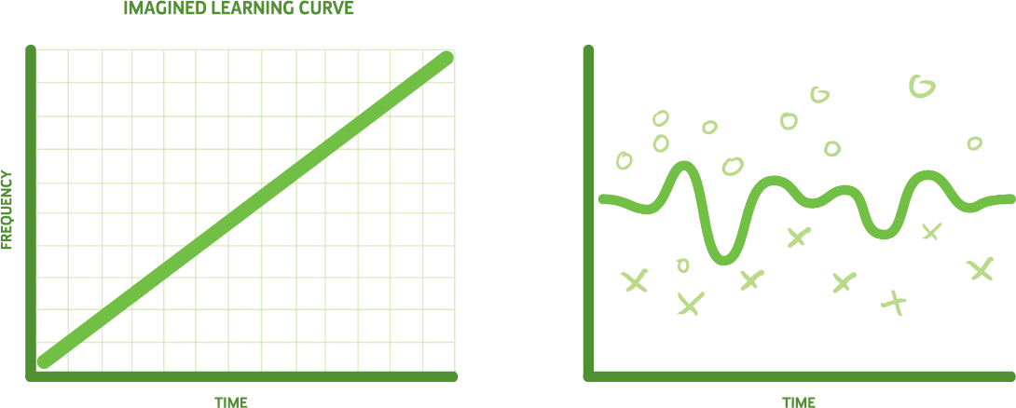
Linear and non-linear learning
WHAT IS THE DIFFERENCE?
Notes:
What is it to be skilful?
Definition presumes it is all about the outcome and nothing about the process. Guy on bike – taught himself and therefore all process
Learning is permanent
Movement should be economical
Skill fits body
Matches task, environment, learner

