Slide 1
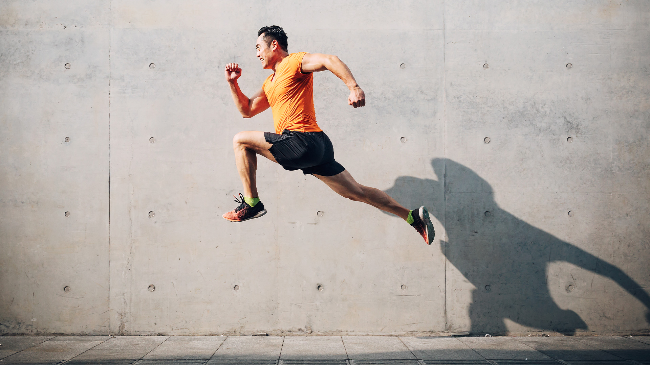
SPORT AND RECREATION
CONTEMPORARY SKILL ACQUISITION WEEK 4
Newell’s Model of Motor Control
Dr Sarah-Kate Millar

Slide 2
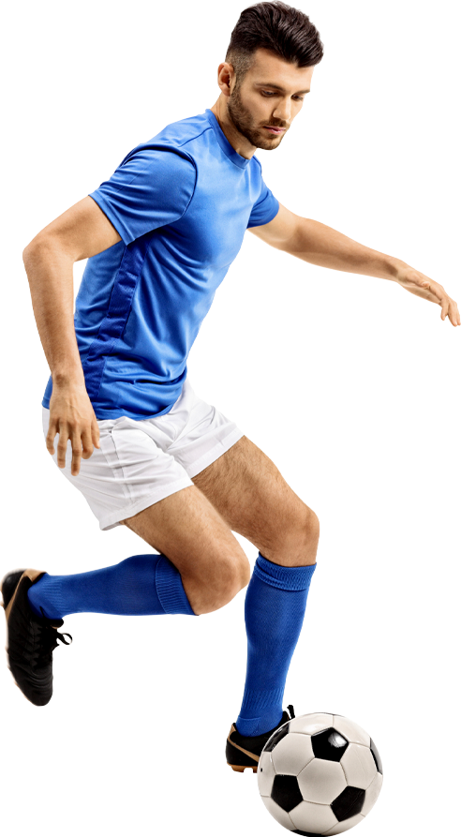
Performer
Adapted from Karl Newell (1986)
How performance emerges under constraints
Environment
Task
Functional behaviour selected under constraints

Slide 3
Dynamic Pattern Theory (Newell, 1986)
Cognition
Flexibility
Motor abilities
Individual Capabilities
Strength/power
Sensory loss
Cardiovascular
Speed/accuracy requirements
Environmental Constraints
Task Demands
Surface type
Moving
Seated
Lighting
Standing
Visual flow
Environmental stability
Number of tasks
3 categories of constraint (+ examples)

Slide 4
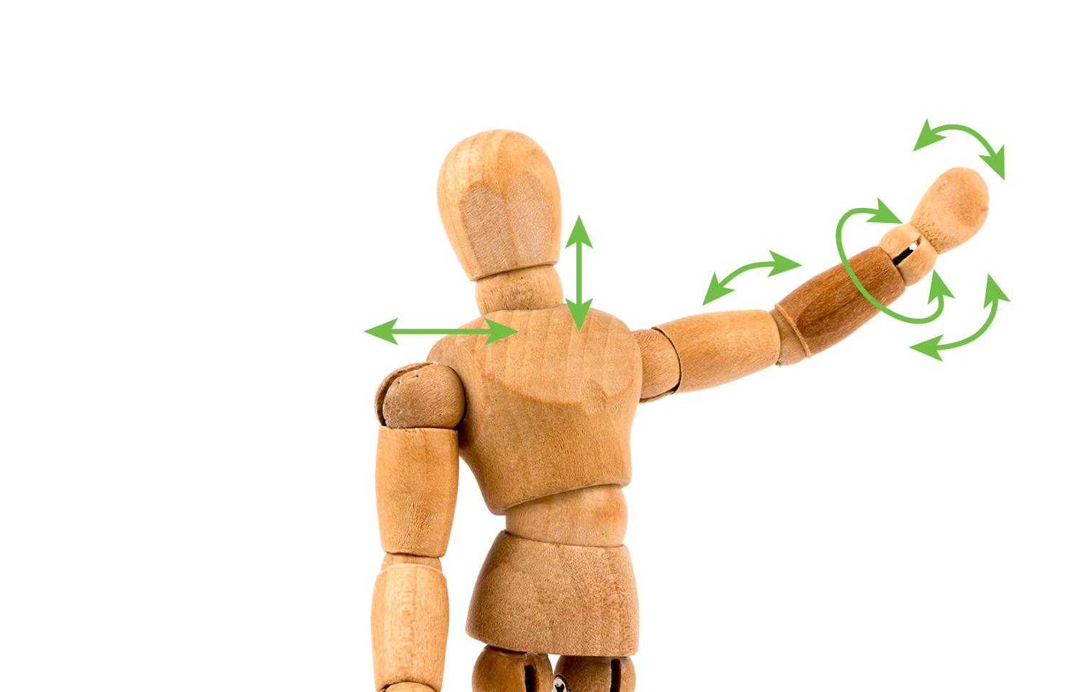
Degrees of Freedom (DoF)
A DoF is an independent variable (part) that can move, eg your elbow
The human body has 244 degrees of freedom. There are around 230 joints in the body, most of which have one degree of freedom (DoF). Some joints have multiple degrees of freedom (DoF) - for example, the hip and the shoulder joints have at least 3 DoF
Shoulder up & down
Wrist rotate
Elbow up & down
Wrist left & right
Shoulder forward & backward
Wrist up & down

Slide 5
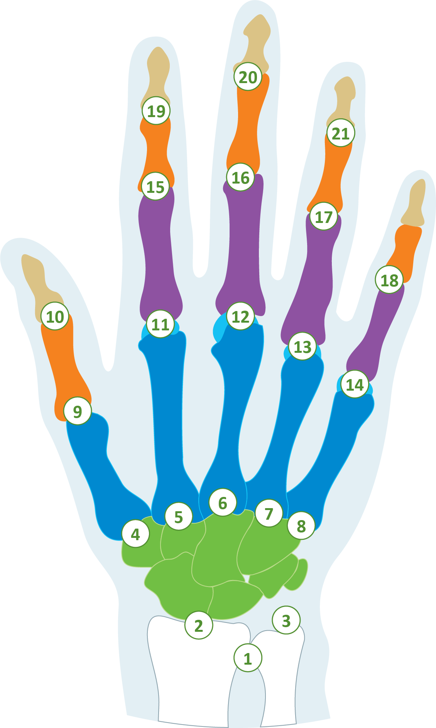
Degrees of Freedom in the human hand
27 Bones
22 Degrees of freedom
14 Phalanges
5 Metacarpals
8 Carpals

Slide 6
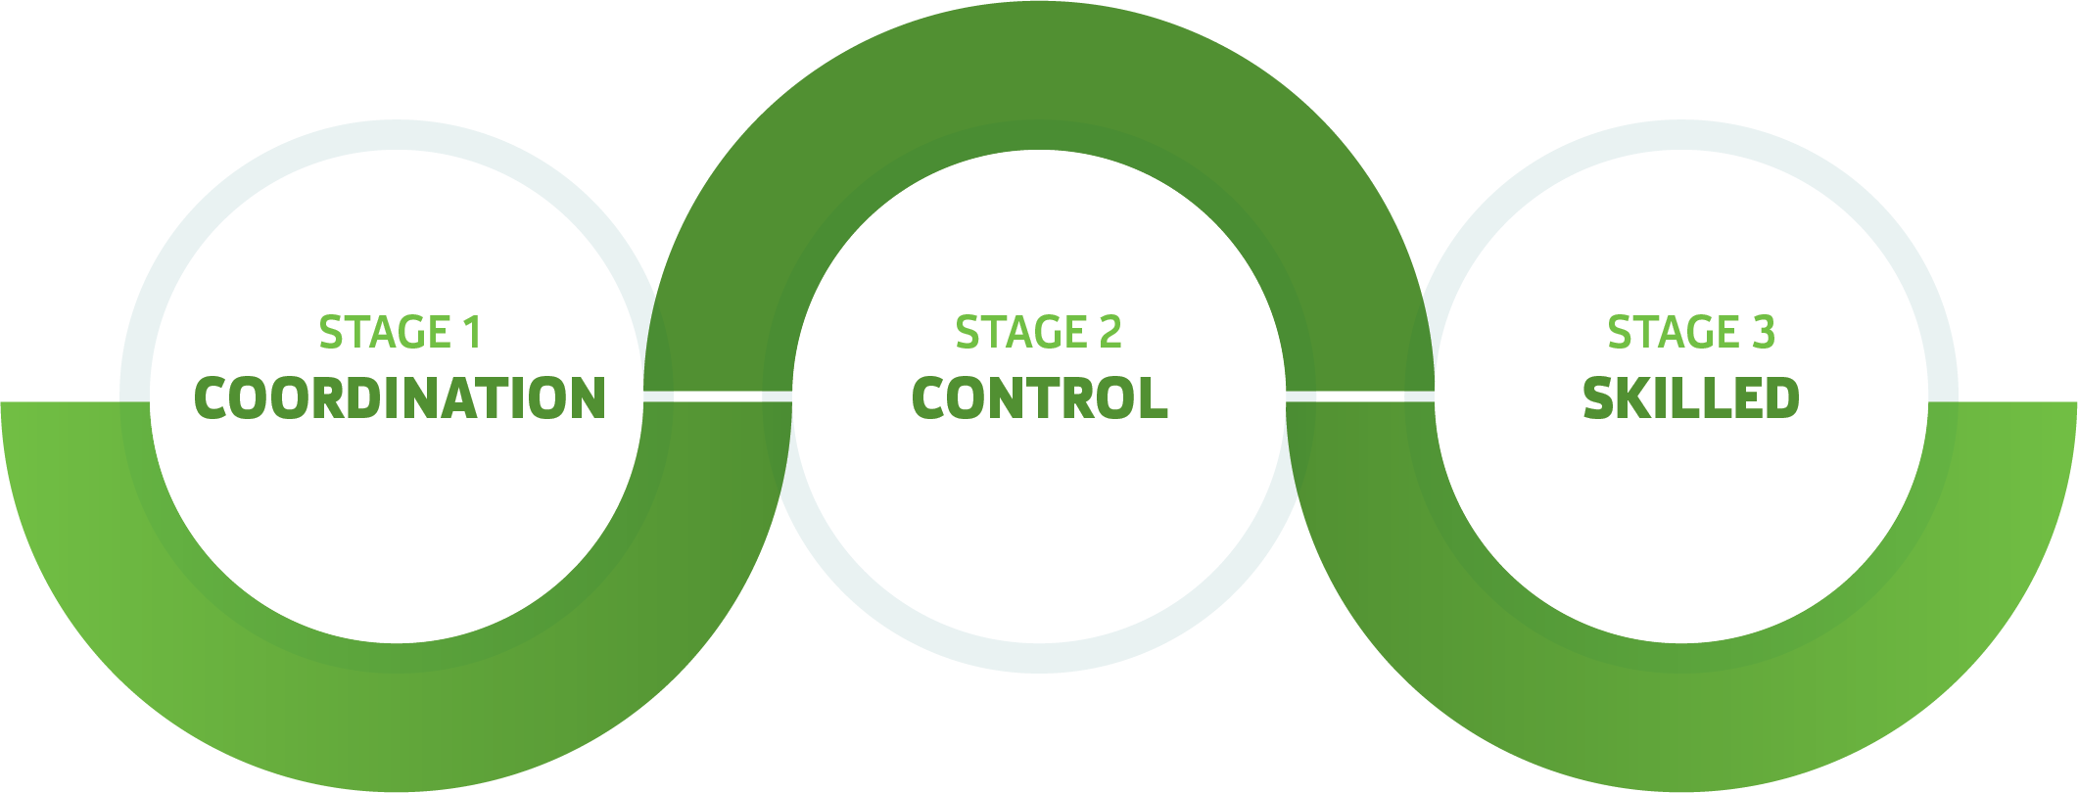
Newell’s Model of Motor Learning

Slide 7
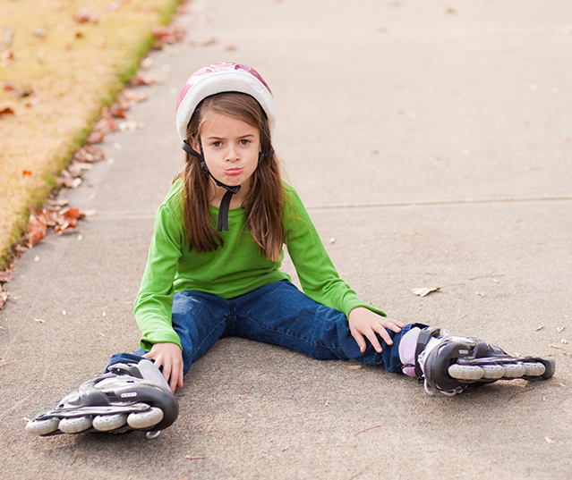
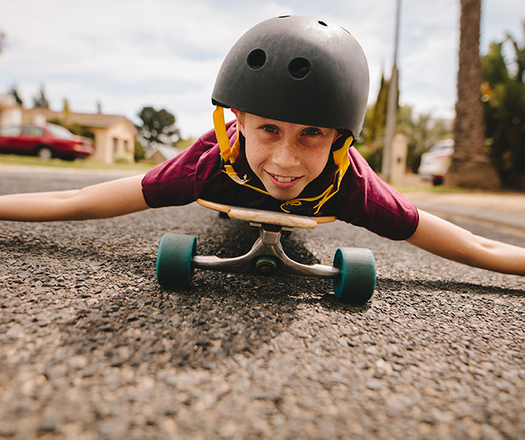
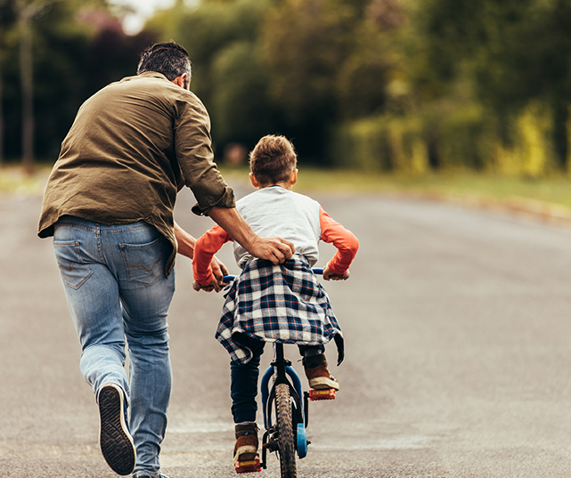
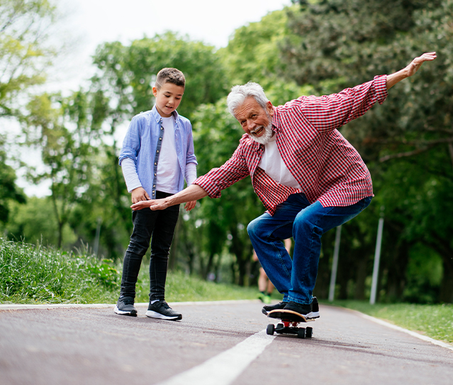
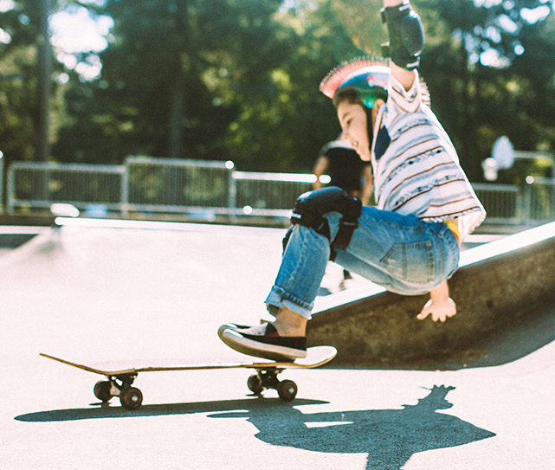
What does new learning look like?
Notes:
Students brain storm their own words, ideas and then images. Include stories or try an activity where most people are new. E.g kneel or stand on a Swiss ball. Get them to come up with words, images about early learners; these may or maybe not be young people . Could try non-dominate hand javelin with a run up

Slide 8
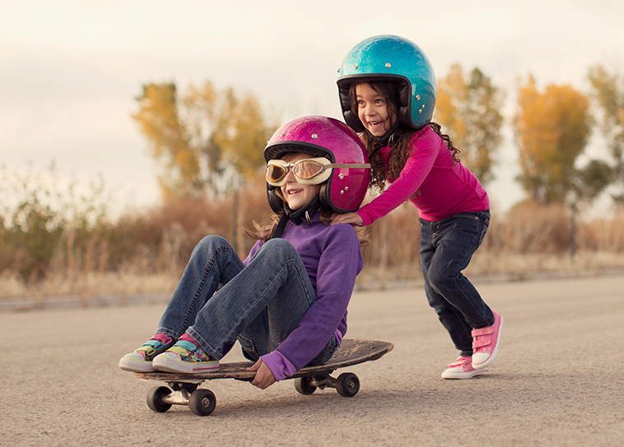
Stage 1 Coordination
Assessable coordination patterns form the large number of DoF available
Eg volleyball serve; coordinate throwing and hitting arm, with legs. Transfer and coupling DoF, often freezing Exploring is key
Not linear or permanent changes. Depends on constraints.
Notes:
As we move, the environment reveals more tools. As we move we see better. E.g. Receiver of a serve in a tennis match may move themselves from side to side.
Being skillful. E.g. a chip in rugby. Chipper watches the distance between the players. Also looks at the angle of the ball cos that determines how fast they have to run.
(rugby)
Crazy soccer dribble
https://www.youtube.com/watch?v=NLK-hJKfhxs

Slide 9
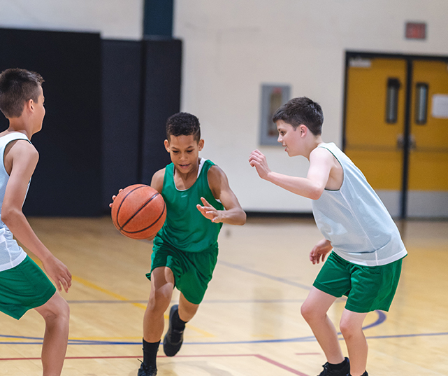
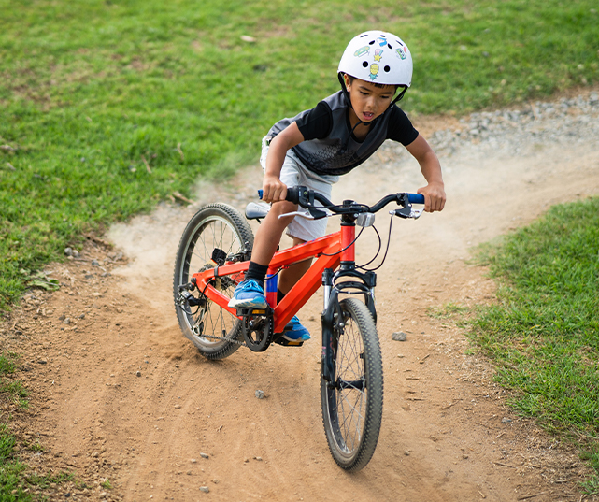
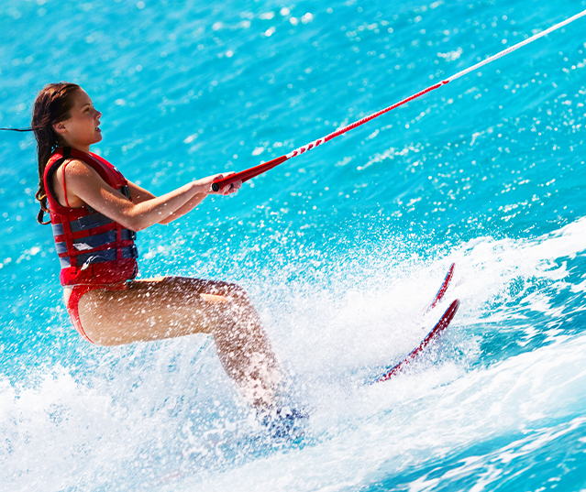
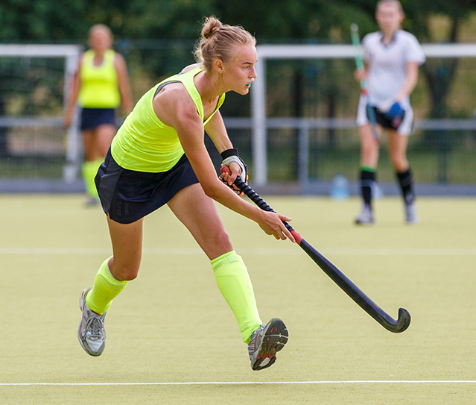
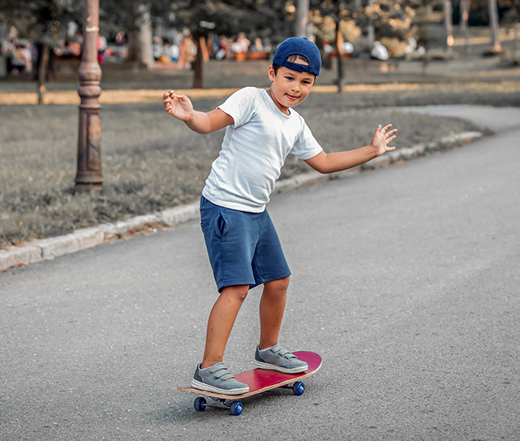
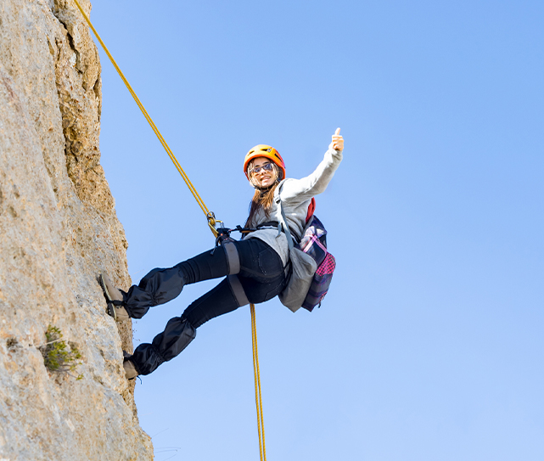
What do you notice after the early learning?
Notes:
Students brain storm their own words, ideas and then images. Include stories or try an activity where most people are new. E.g kneel or stand on a Swiss ball. Get them to come up with words, images about early learners; these may or maybe not be young people . Could try non-dominate hand javelin with a run up

Slide 10
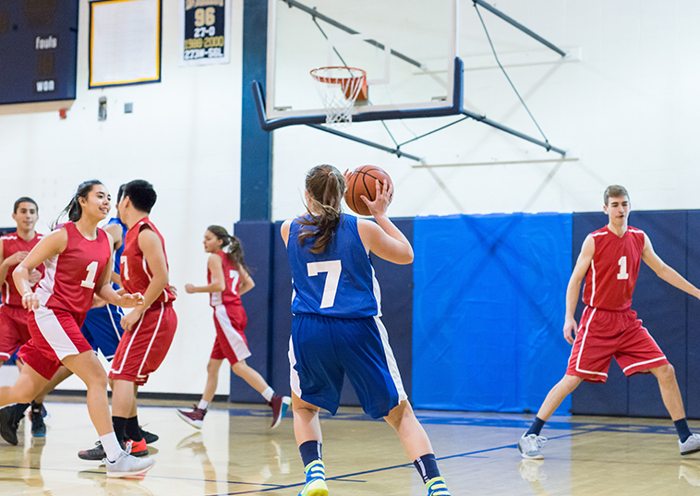
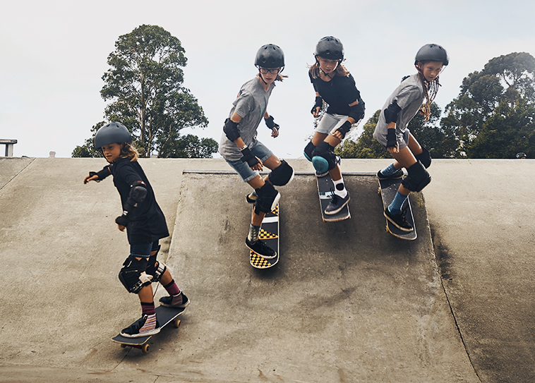
Stage 2 Control
Have relationship between body parts, now more adaptive to the changing conditions, eg hitting the ball at different heights, to different places over the net.
More able to adapt to environmental info and the performers intentions and/or emotions
Not linear or permanent changes. Depends on constraints.

Slide 11
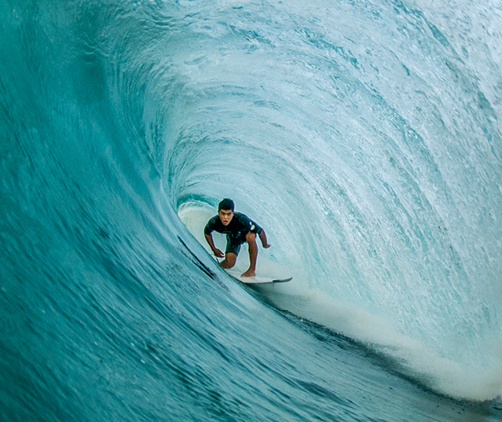
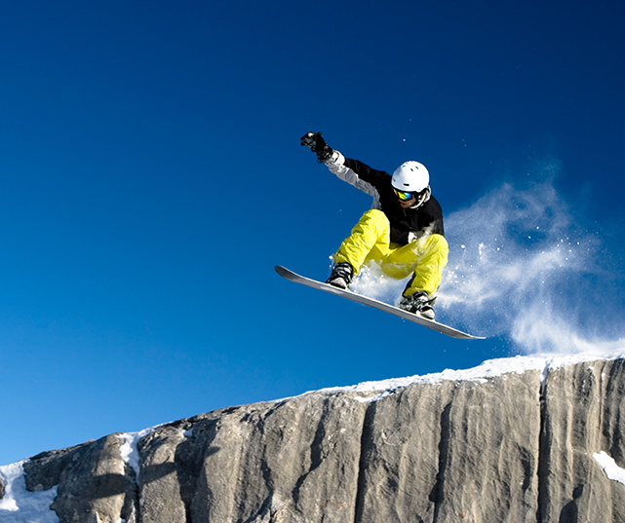
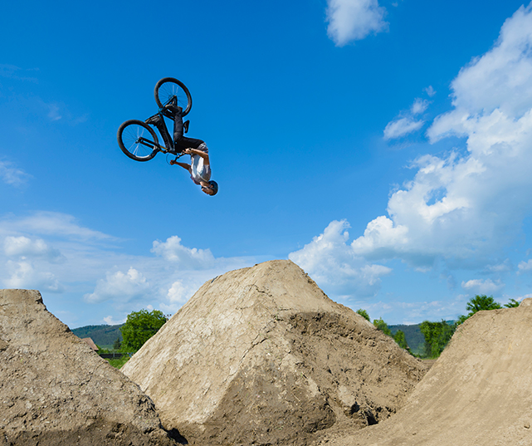
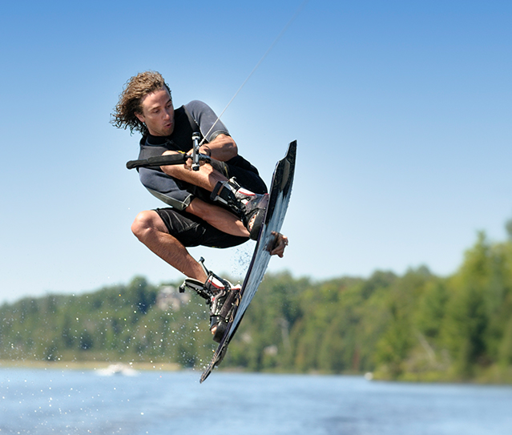
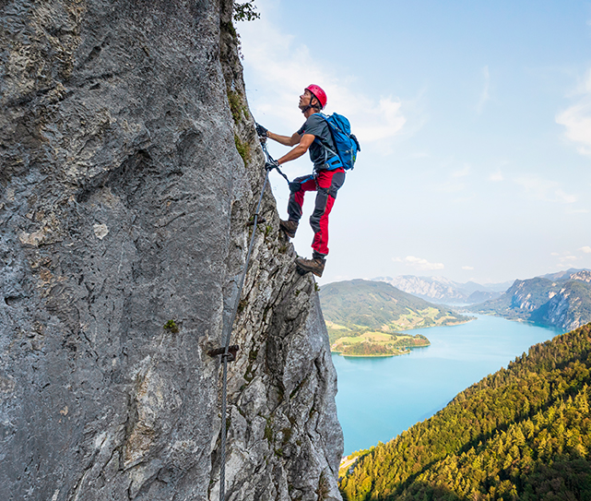
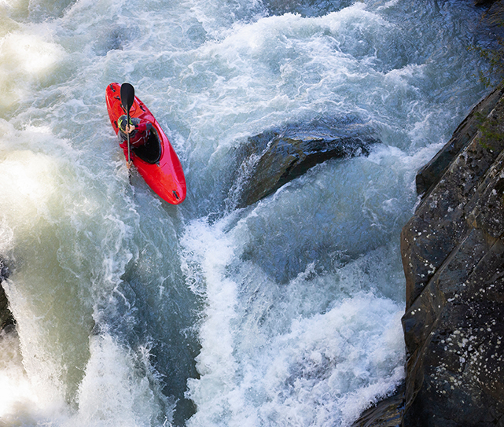
What does skillful look like?
Notes:
Students brain storm their own words, ideas and then images. Include stories or try an activity where most people are new. E.g kneel or stand on a Swiss ball. Get them to come up with words, images about early learners; these may or maybe not be young people . Could try non-dominate hand javelin with a run up

Slide 12
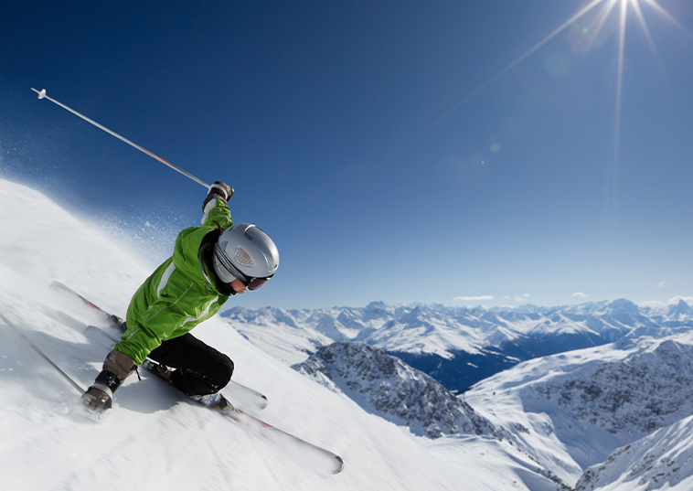
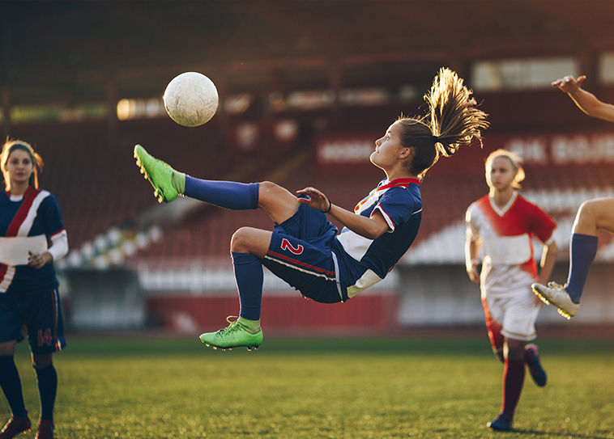
Stage 3 Skilled
Flexible and open to exploit environmental information
Have flexible and efficient actions (eg alter force, direction of serve)
Often less DoF used (and unfreezing), discovery learning still important.
Not linear or permanent changes. Depends on constraints.

Slide 13
Newell’s Model of Motor Learning
Stage 1 – Coordination (Assessable coordination patterns form the large number of DoF available) Eg volleyball serve; coordinate throwing and hitting arm, with legs. (Transfer and coupling DoF, often freezing) Exploring is key
Not linear or permanent changes Depends on constraints
Stage 2 – Control (Have relationship between body parts, now more adaptive to the changing conditions, eg hitting the ball at different heights, to different places over the net) More able to adapt to environmental info and the performers intentions and/or emotions
Not linear or permanent changes Depends on constraints
Stage 3 – Skilled (Flexible and open to exploit environmental info) - Have flexible and efficient actions (eg alter force, direction of serve) - Often less DoF used (and unfreezing), discovery learning still important.
Not linear or permanent changes Depends on constraints

Slide 14
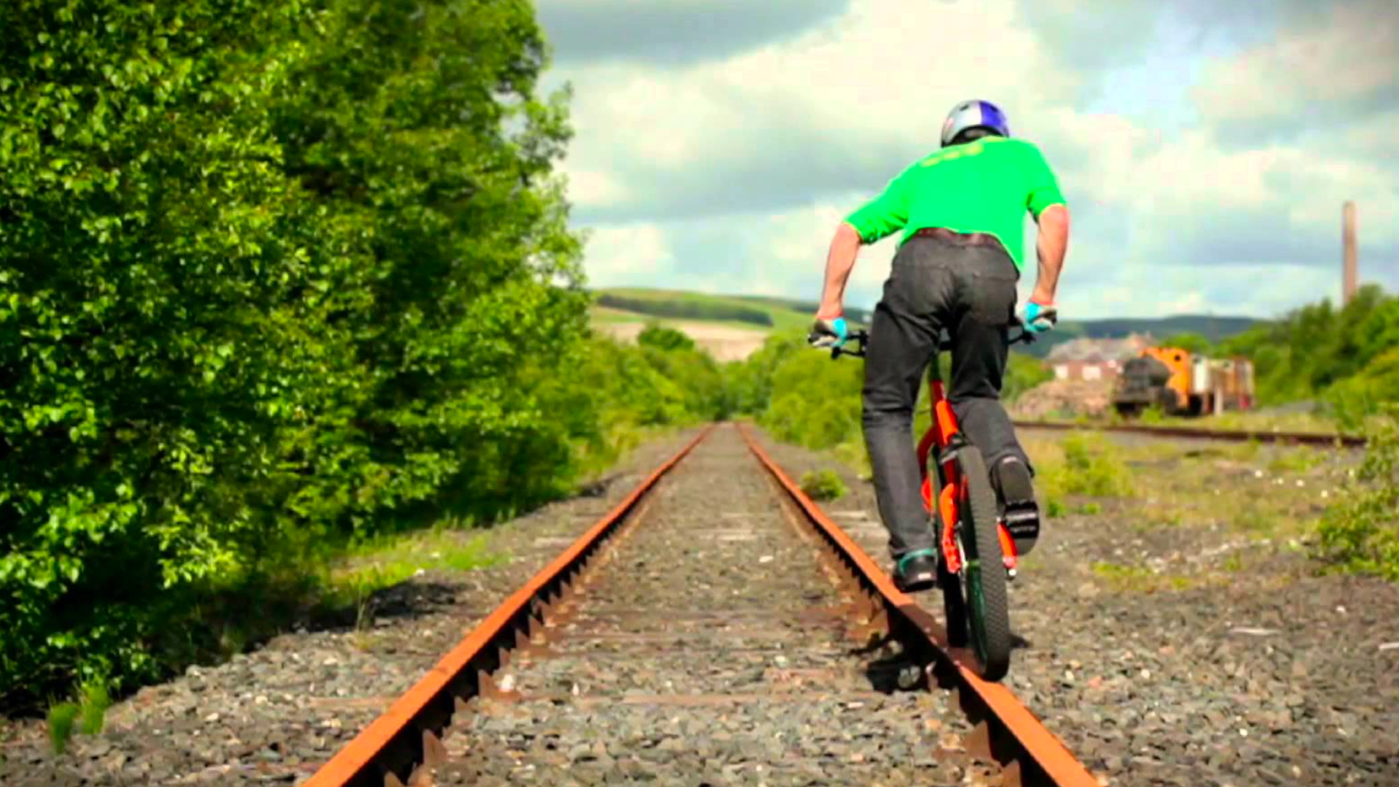
What can you tell about this person?

Slide 15
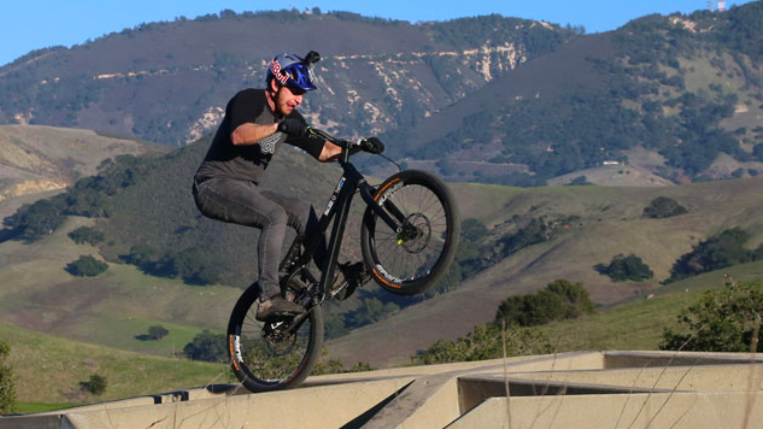
Or this picture?

Slide 16
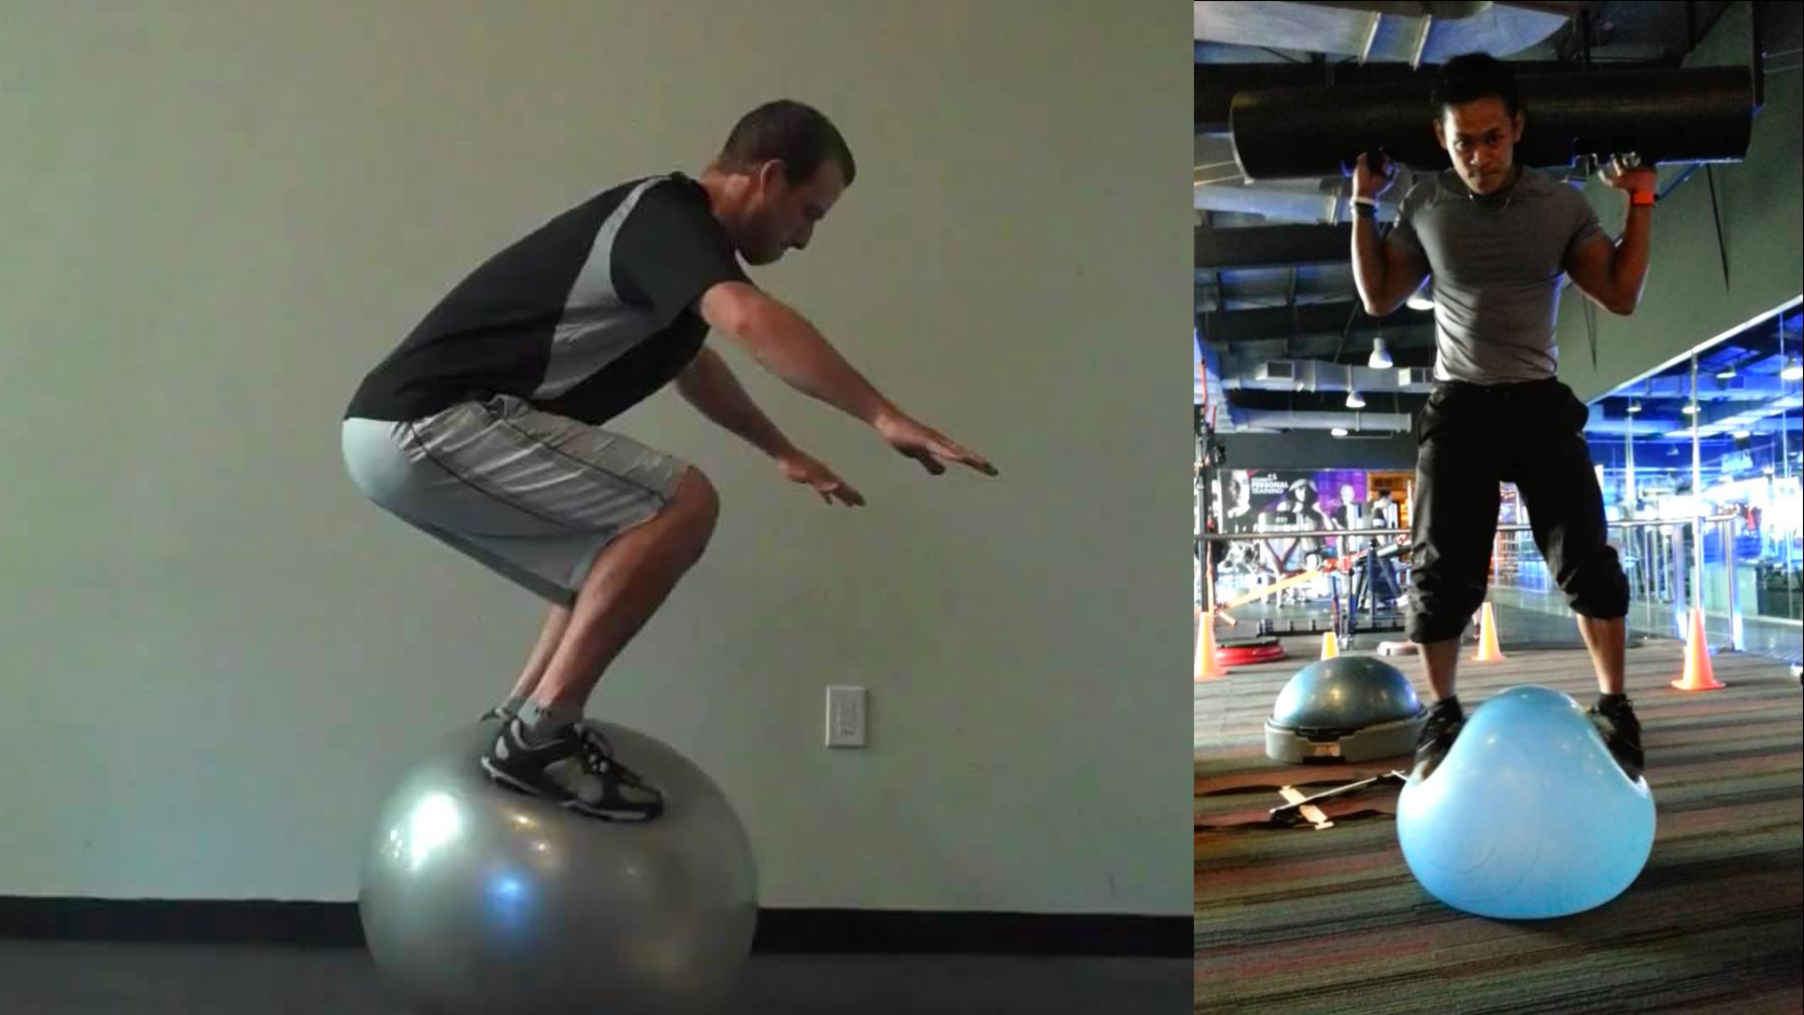
Standing on a swiss ball?

