Slide 1
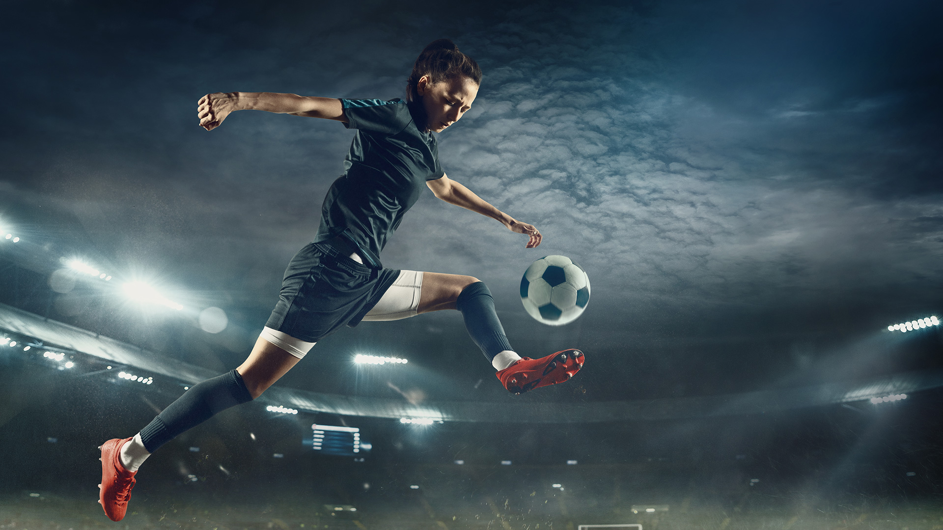
SPORT AND RECREATION
CONTEMPORARY SKILL ACQUISITION WEEK 2
Perception Drives Action
Dr Sarah-Kate Millar

Slide 2
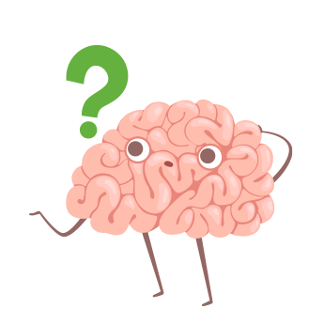
Environment Shapes Action

Slide 3
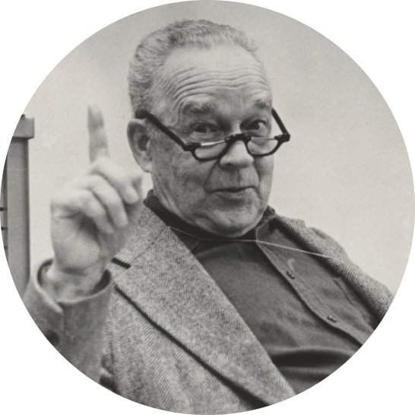
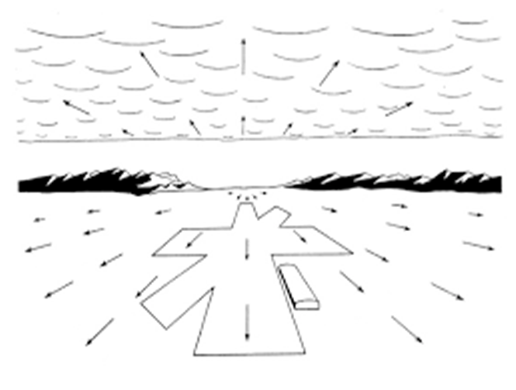
Direct Perception
“Ask not what’s inside your head but what your head’s inside of!”
JJ Gibson 1969
Information is the interaction with the environment
Optic Flow - pilot approaching a runway
Notes:
Role of our senses and that there is a lot of info available at our senses that does not require a lot of complex thinking or instruction in the head. He moved things away from an indirect approach and a constructivist approach
That relationship between you and the environment and that interaction
Came from training pilots and as you move through the environment you have this information available to you – his notion that as we move through the environment, this motion influences our movements.

Slide 5
Perception and Action are Coupled
PERCEPTION
ACTION
Notes:
Circular relationship/
Objects / human beings. Movement is an important part of this. If we did not move, we could not be.
Like dancers - coupled
Action shapes Perception

Slide 6
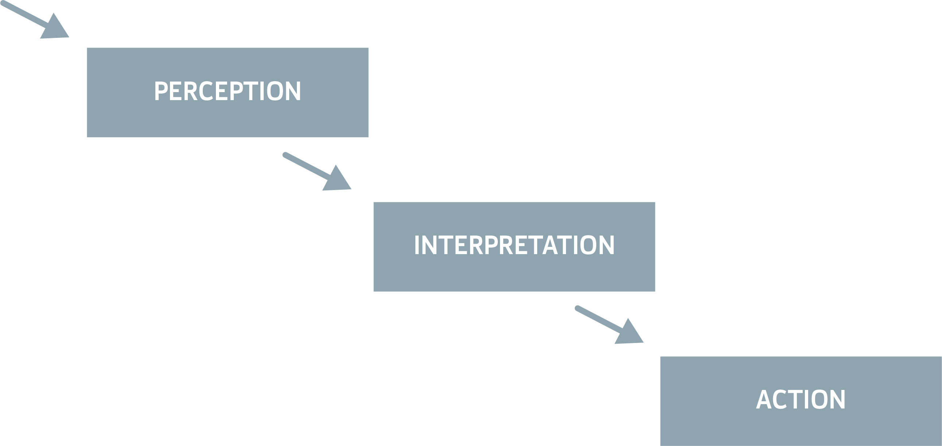
Perceptual Info
Notes:
Information processing model. E.g. braking on a car. Slow motion to react? No. Automatic. We generally do all that without interpretation

Slide 7
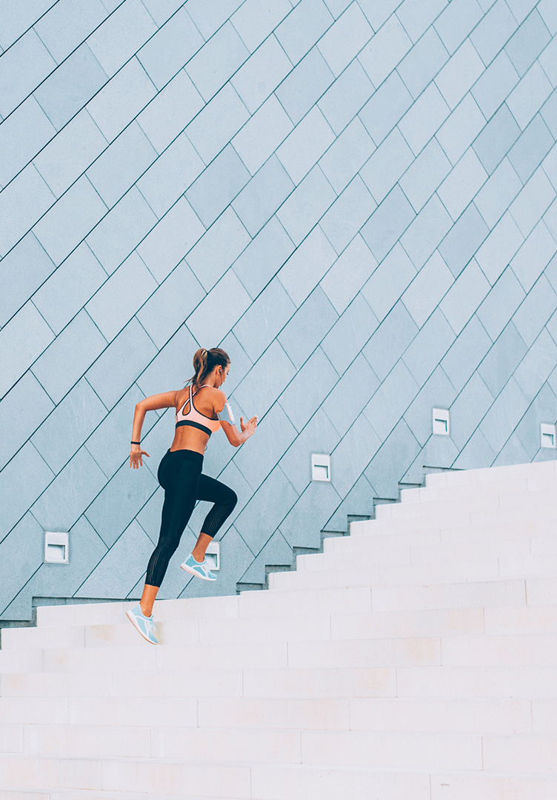
How much do we need to think about?
Perception – it’s a doing thing!
When we move, do we always consciously plan and adjust?
The environment shapes action
How much interpretation is necessary?
Notes:
Stair walking (VIDEO) . Half class walk out and watch. Repeat. What did you notice? Regular distance. Top of step and where you put your toes to get over the step. What tells you that it needs to be that high?
Floor to top of stair. The gap describes the angle and that controls the hip. We trip most on the bottom and top step because you run out of things to see.(you can’t see the gap)
Boundaries. Door frame. We walk through the centre. What did you notice? Walked through the middle of the doorway. Who stopped and thought about that? How did you know – did you measure it? No – perceive through the boundaries either side.
Locomotor stuff is given for free. Perception and action
Lift the chair. Automatically push your centre of gravity back. Sways back. Change in velocity and shirt in centre of gravity enables you to make a postural correction. But we do this without thinking.

Slide 8
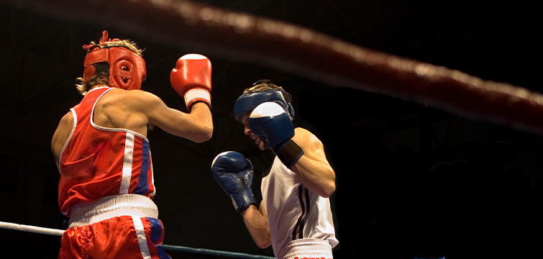
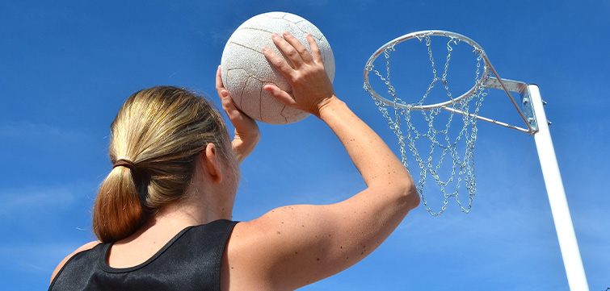
Thinking...
We do think, but we don’t have to think about movement all the time
The best or most skilled performers only “think it” when they have to
The goal of being skillful is to think less about the easy stuff and only when necessary
“Tuning in” to the environment
Notes:
We often make mistakes when we “over think” things. E.g. telling small children to look at a step. They then wave their foot around.
Execution of the skill – environment oriented. E.g. learning to drive a car. Manual. Learner drivers look at stick to change gear and then with other hand vear to side of the road.
Learning and being skillful is a process of learning and linking perceptual properties to movement
Purpose of the skill – motor skill learning – mechanical and rote learning. But how much thinking do we do?
Tuning in to the environment = being aware, perception, interpretation
Place yourself on court will be, not where it is (give yourself more time)
Boxing – how do boxers know when to go? – when one moves the shoulder or backwards… MA had slow reaction times, but good at turning in the opponents body movements. (early info)
Tennis – early info in the serve.

Slide 9
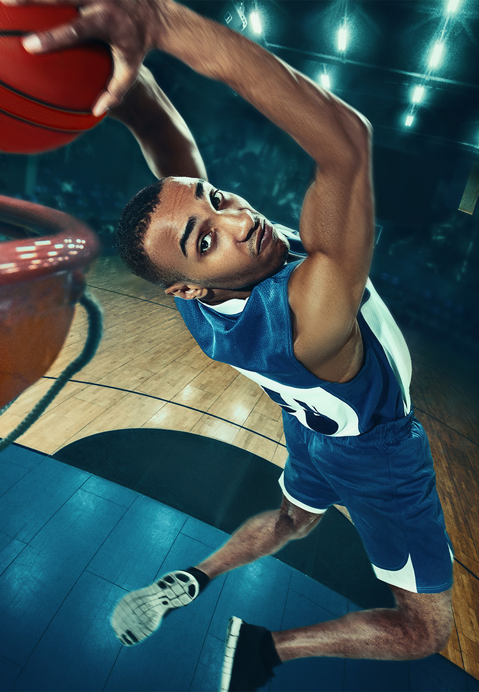
Theory of direct perception
Gibson (1950, 1966, 1979) we don’t have to think (interpret) in order to move effectively
Degrees of freedom problem
Relationship of the environment and how it actually shapes movement
The basic degrees of freedom (lots of moving parts), how do they work together to solve a movement problem?
Notes:
Perception action reciprocity. As you move the world changes, as the world changes, you move more.
e.g. bball player pumps ball on dribble, props forward and back and waits for defence to be on their heels before they drive forward, thus beating the player.
It is the changes in the action or the ball that gives you the information. This = direct perception
Basic degrees of freedom problem. How do they work together to solve a movement problem. They are told by the environment. E.g. steps. Angle of step controls your hip.
Hand ball shaped. Fingers with lots of joints and moving parts (21 in hand) so how do we shape it in order to catch a ball? Shape it in the form of what you are going to catch. E.g. round

Slide 10
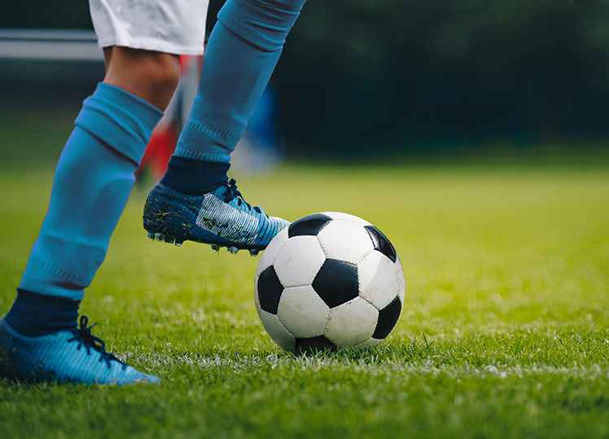
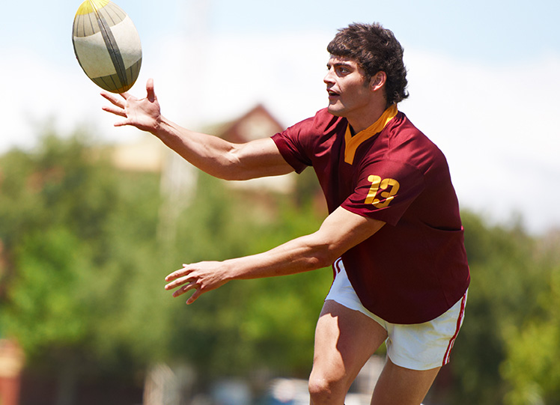
Direct Perception is...
The activity of getting information from the ambient array of light.
The emphasis on the nature of the information sources used to support action.
That is: Environmental information is coupled to movement
Notes:
As we move, the environment reveals more tools. As we move we see better. E.g. Receiver of a serve in a tennis match may move themselves from side to side.
Being skillful. E.g. a chip in rugby. Chipper watches the distance between the players. Also looks at the angle of the ball cos that determines how fast they have to run.
(rugby)
Crazy soccer dribble
https://www.youtube.com/watch?v=NLK-hJKfhxs

Slide 11
Affordances
"Information for" related in terms of what the information offers the perceiver.
Gibson (1986)… the acts or behaviours permitted by objects, places and events. The affordances of the environment, are what it offers the animal, what it perceives or furnishes, either for good or ill.
An affordance is unique to that animal/person/performer.
An attractor state is a preferred pattern to solve a movement problem, eg how we pick up something or stand up from the floor.
Notes:
More likely to do it again if it has a positive outcome. Less likely to do it if it is negative.
Last response determines whether you will do it again. Thing that you did last means likely to do it again
Law of exercise – repetition means more likely that you will repeat it
https://www.youtube.com/watch?v=Bhy-T55gpTQ

Slide 12
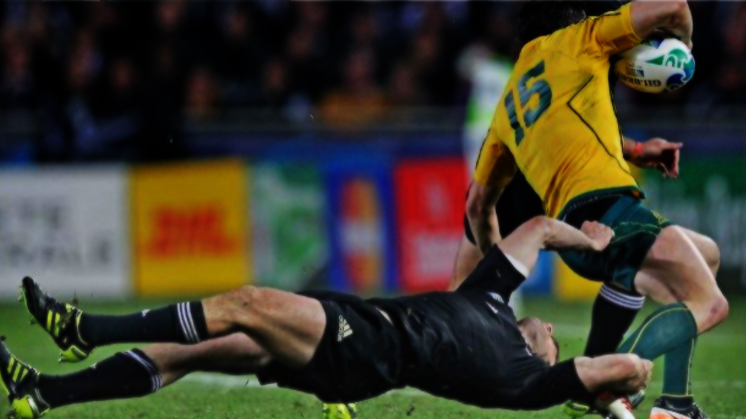
Affordance – what does the situation allow for this performer?
Notes:
As we move, the environment reveals more tools. As we move we see better. E.g. Receiver of a serve in a tennis match may move themselves from side to side.
Being skillful. E.g. a chip in rugby. Chipper watches the distance between the players. Also looks at the angle of the ball cos that determines how fast they have to run.
(rugby)
Crazy soccer dribble
https://www.youtube.com/watch?v=NLK-hJKfhxs

Slide 13
Specifying Information
Functional perception – action couplings, ie defenders.
Need to keep key/specifying information in the performers practice environment, eg speed/direction of players/equipment.
Functional affordances – opportunities for action, eg piggy in the middle vs passing a ball between two OR a rowing machine and on-water rowing.

Slide 14
Research Evidence
Lee & Lishman’s (1978)
Swinging Room Experiment
Savelsbergh (1995)
Inflating Balls Experiment
Notes:
Lee and Lishman
Swinging room. Board on ground and keep balance. Walls move and person falls off the board.
https://www.youtube.com/watch?v=F4xenIulg_8 MOVING ROOM
Savelsbergh
Catching balls as they inflate or deflate. Miss catch. As the ball deflates. Hits tips of fingers as the ball inflates. Subtle changes in the size of the ball mixes up your invariant and affordance. Information about and information for.

