Slide 1
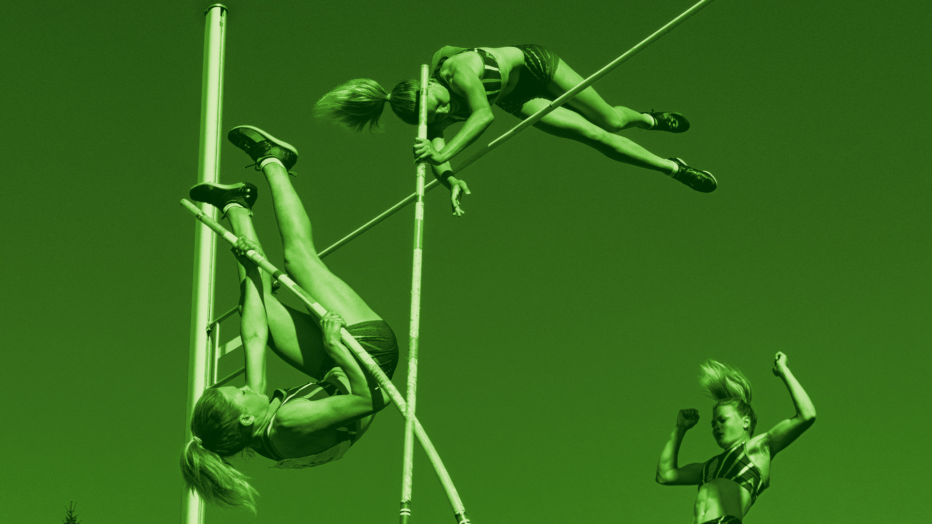
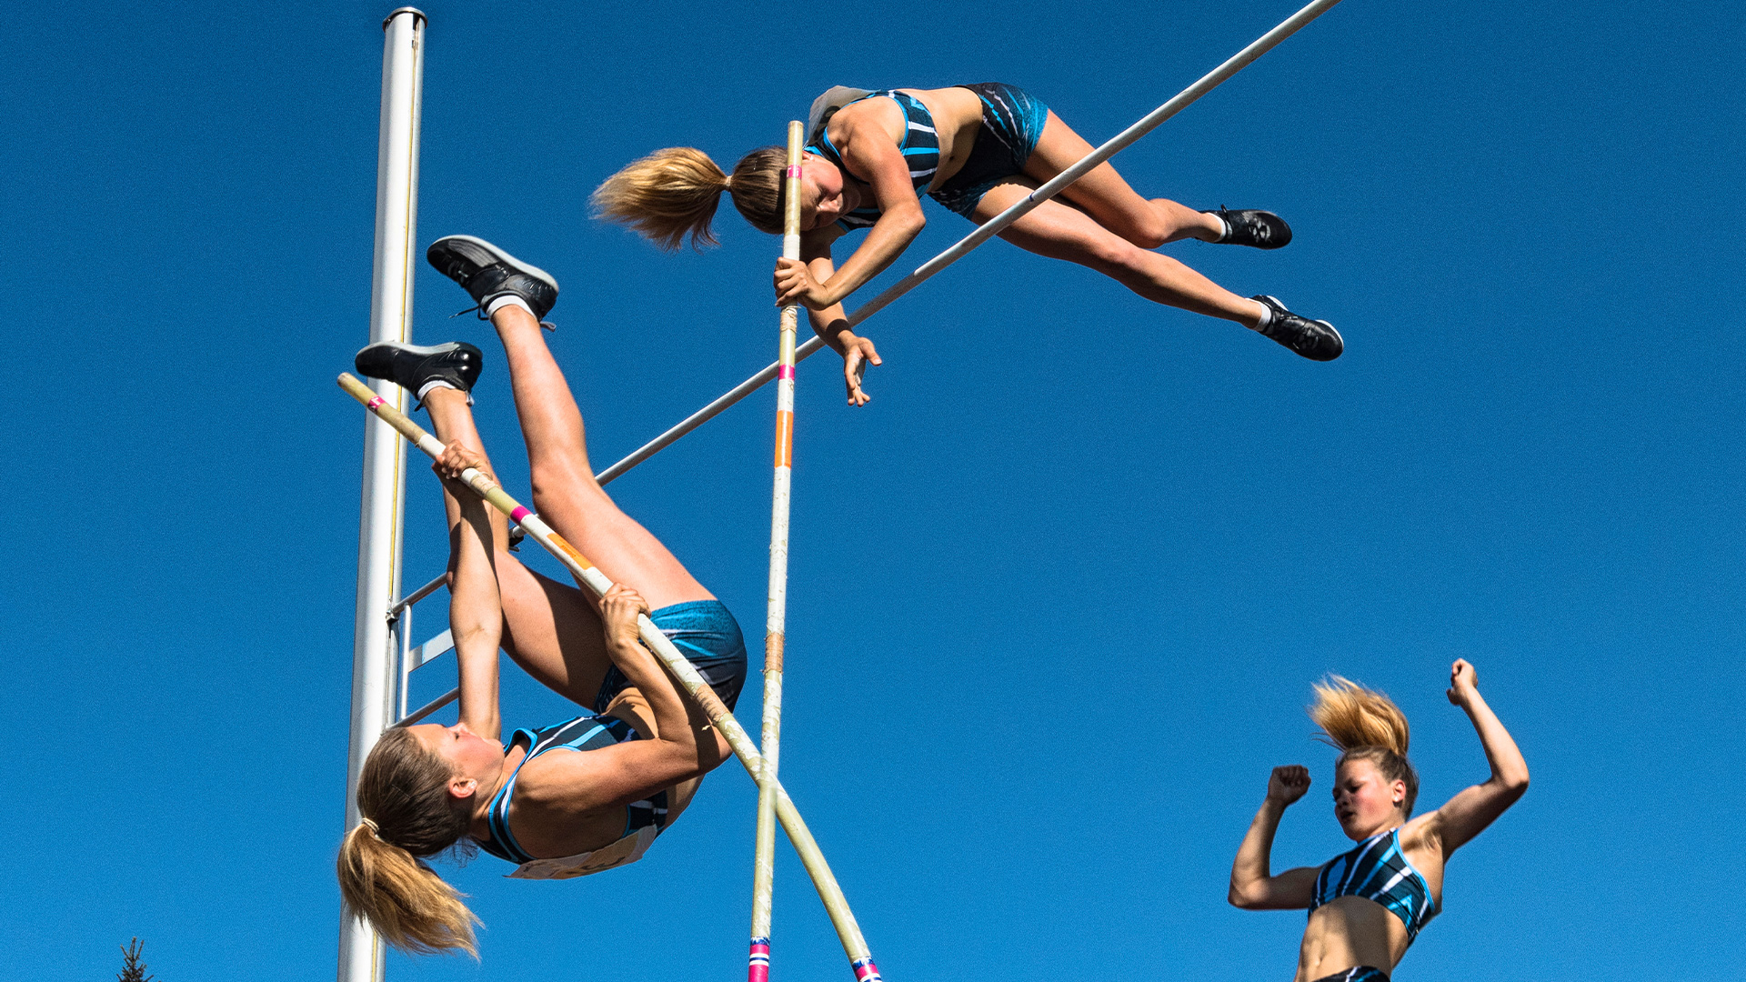
SPORT AND RECREATION
CONTEMPORARY SKILL ACQUISITION WEEK 5
Movement Variability & Learning Through Performance
Dr Sarah-Kate Millar

Slide 2
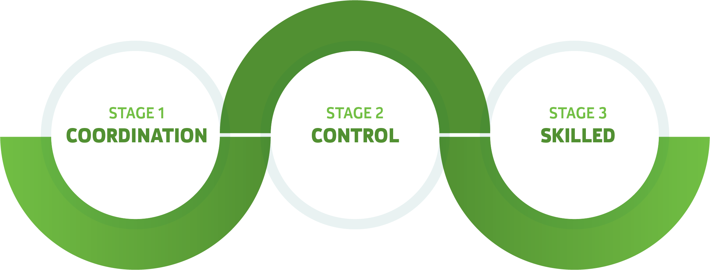
Newell’s Model of Motor Learning

Slide 3
Newell’s Model of Learning (1985)
SKILL
CONTROL
COORDINATION
Notes:
Move from : learners struggle to acquire a functional movement pattern; often looking to use stable movement patterns that they already have
To: where learners are able to perform with consistency in changing environments (i.e. speed and force changes)
Some criticism over the internal vs external findings. E.g. focusing on outcomes for results, complete novices to a novel task, as apposed to beginners with some esp movement patterns
Maybe need to think about when to internal vs external focus of attention? Maybe internal focus in early learning when form is the aim e.g. dancing/diving/ice-skating/gymnastics as apposed to throwing a ball to someone.
Most time is spent in the control stage of learning
Movement dynamics and movement effects

Slide 4
Degrees of Freedom problem?
A Degree of Freedom is any value that is free to vary.
792 muscles, over 100 joints, thousands of motor units.
Notes:
DoF – anything that can change or be changed (in biomechanical terms)
Elbow 2 degrees of freedom – flexer and a rotator
27 degrees of freedom in your hand. Issue of control. If 27 different ways to vary. How do you get control?
A Physical and environmental shortcut = making good use of gravity (it goes for free)
e.g. Reaching and grasping. We can be very effective at picking things up. 14 points in fingers – 28 degrees of freedom (flexion and extension). But we do not use all of these when we grasp something (just use finger and thumb)

Slide 5
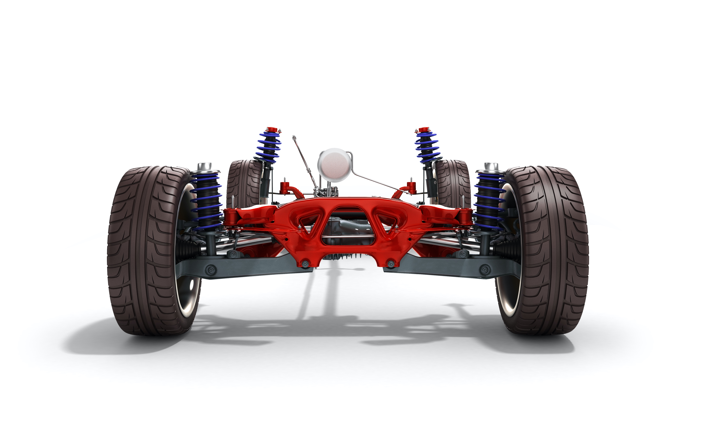
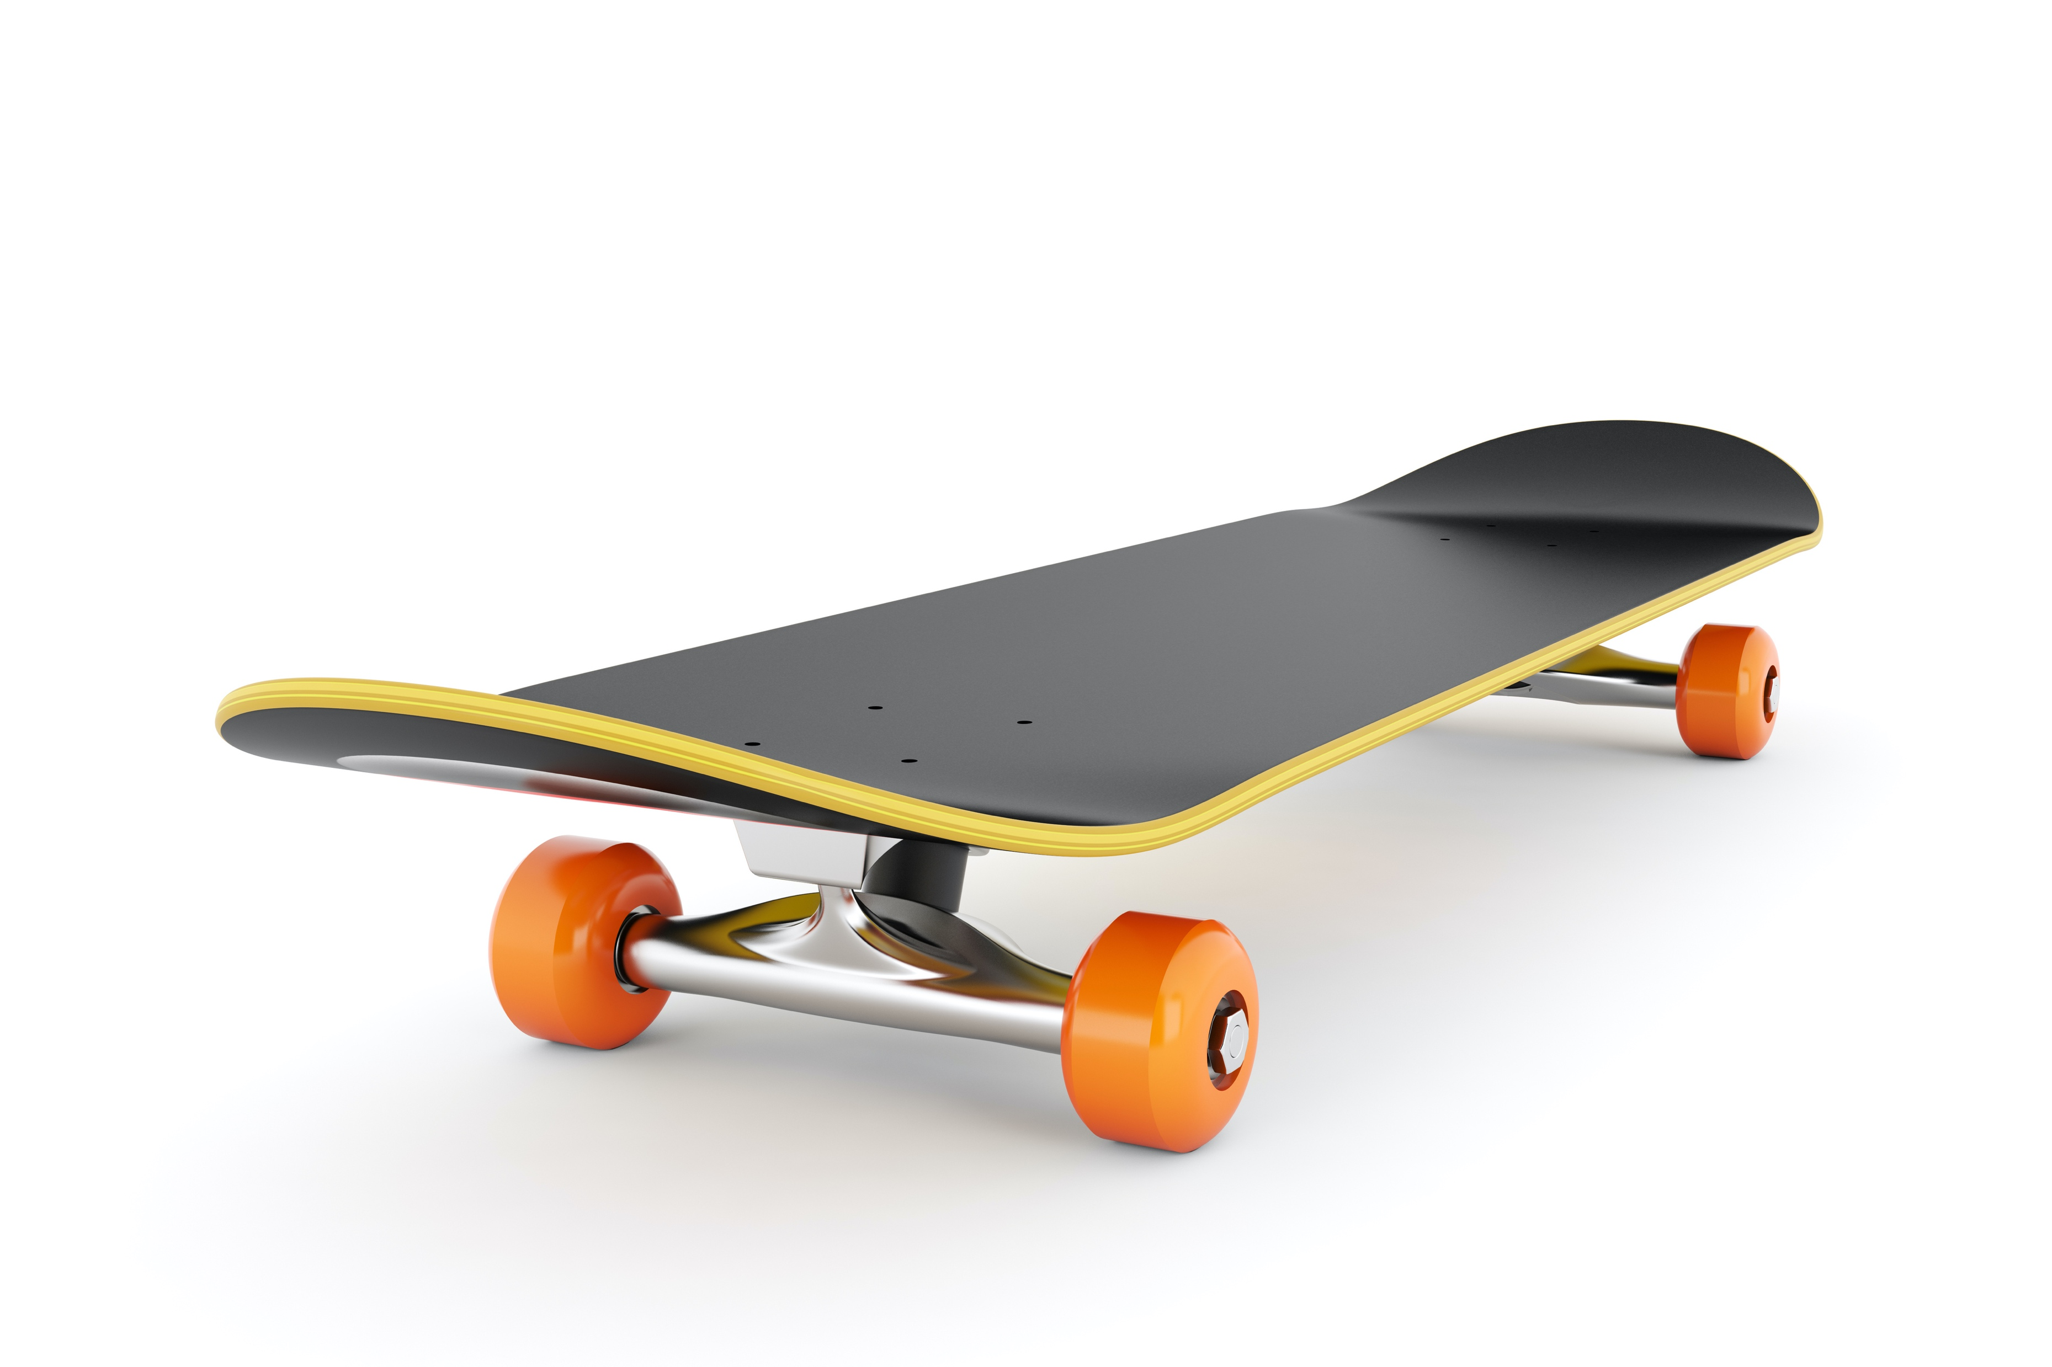
So how do we solve the Degree of Freedom problem?
Like driving a car and controlling each wheel individually
Skateboarding
Coupling (context dependent)
Notes:
Coupling. The rod between the two wheels controls the steering of the car
Skateboard – 4 wheels move together. Because they are joined together. Different angles using one movement

Slide 6
Co-ordination & the Degrees of Freedom Problem
Co-ordination = is an assemblage of couplings
Process by which an individual constrains or condenses the available degrees of freedom into the smallest necessary to achieve a goal
Notes:
Try and get your fingers to move independently
games – circle with hand draw square with foot
DoF – smallest number of logical couplings

Slide 7
Are two movements the same?

Slide 8
Is it possible to exactly repeat a movement?

Slide 9
Movement Variability
Large number of DoF in the body; allows it to move in numerous ways.
Research to show that learners can achieve the same outcome in lots of different ways. Eg how many golf styles are there?
Variability in the system is not only expected, it is critical.
The system is not constant or fixed, but rather dynamic, variable and adaptive.

Slide 10
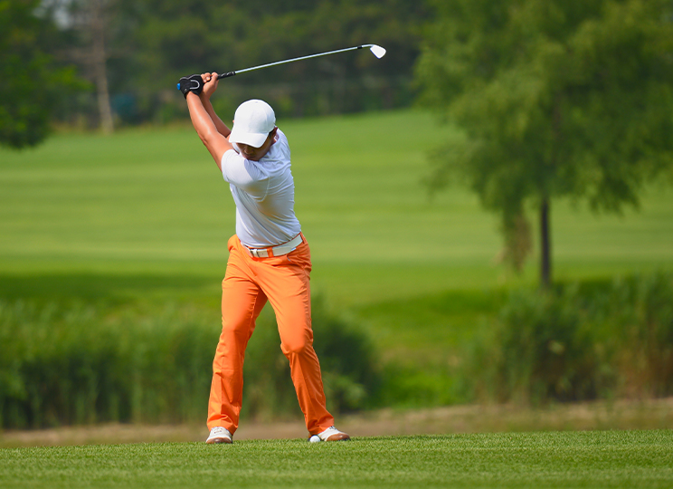
Movement Variability Continued
To learn, a stable system must give way to a new state.
Skill learning is a dynamic and developmental process-ever-changing and present throughout the entire lifespan.
Individuals are composed of many complex, co-operative systems. Behaviour is related to the development of many systems.
Notes:
Historical perspective of MSL
Control consistency and execution. Focus on outcome of task. Reduction in variability to get the result
What we should be looking for is distinction that is useful for bodies and variability that is not useful for bodies
Big difference is that we are focusing on bodies and not outcomes
Variability – mistakes are evident and they are necessary.
When a coach says we learn from our mistakes – they are just focusing on the outcome – not the understanding of dynamical systems theory (movement, environment, how we learn)

Slide 11
Learning is about working with variability not eliminating it.
In skill acquisition (or learning) it is not about figuring out all the instructions necessary for the successful execution of a task, but rather, figuring out the physical and environmental short cuts that make it manageable. (Oldham, 2010)

Slide 12
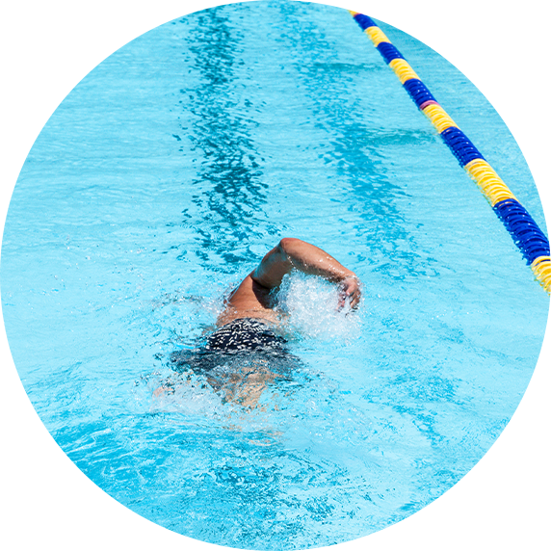
Learning vs Performance
In groups, discuss the two and provide an example of both.

Slide 13
Learning = ---- + ---- Liao, & Masters, (2001).
Learning =
Retention
+
Transfer
In the right practice conditions, people can retain the same essence of the movement pattern. Able to repeat movement
The ability to perform a trained response to an untrained task, or new/different task.

Slide 14
Are all tennis serves the same? Why not…

Slide 15
Functional Variability
It is impossible to repeat a movement
There will always be differences in the human body at any given time, eg fatigue, heart rate, long jump run ups etc
Need to be able to adjust to varying conditions – rain, wind, people
Functional variability is considered a sign of skill, not weakness. Can they achieve a set outcome in multiple ways? Skillful ✅ 😀
Consistency of outcome
Notes:
When manipulating the constraints it is important to ensure that are all considered as they interact with each other
An experienced teacher/instructor would consider the outcome or movement goal and know which constraints to manipulate and in what way

Slide 16
SPORT AND RECREATION
CONTEMPORARY SKILL ACQUISITION WEEK 5
Representative & Practice Design
Dr Sarah-Kate Millar

Slide 17
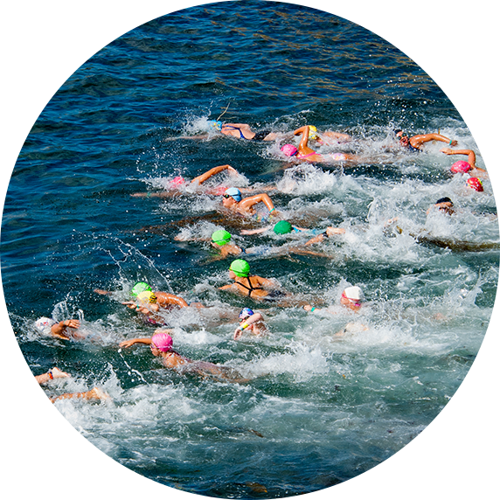
Planning for learning…

Slide 18
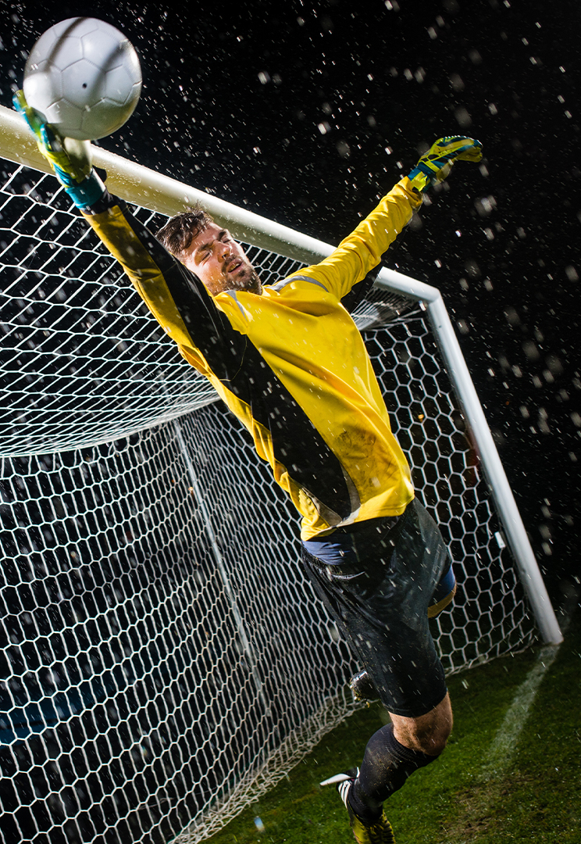
Perception-action couplings
Developing functional perception-action couplings – key skill required in successful performance. Eg picking up the speed and angle of a ball if you are a goalkeeper.
There is information available in all situations, but some information is more important than others, eg where a defender is will determine the speed, angle, type and timing of a pass.

Slide 19
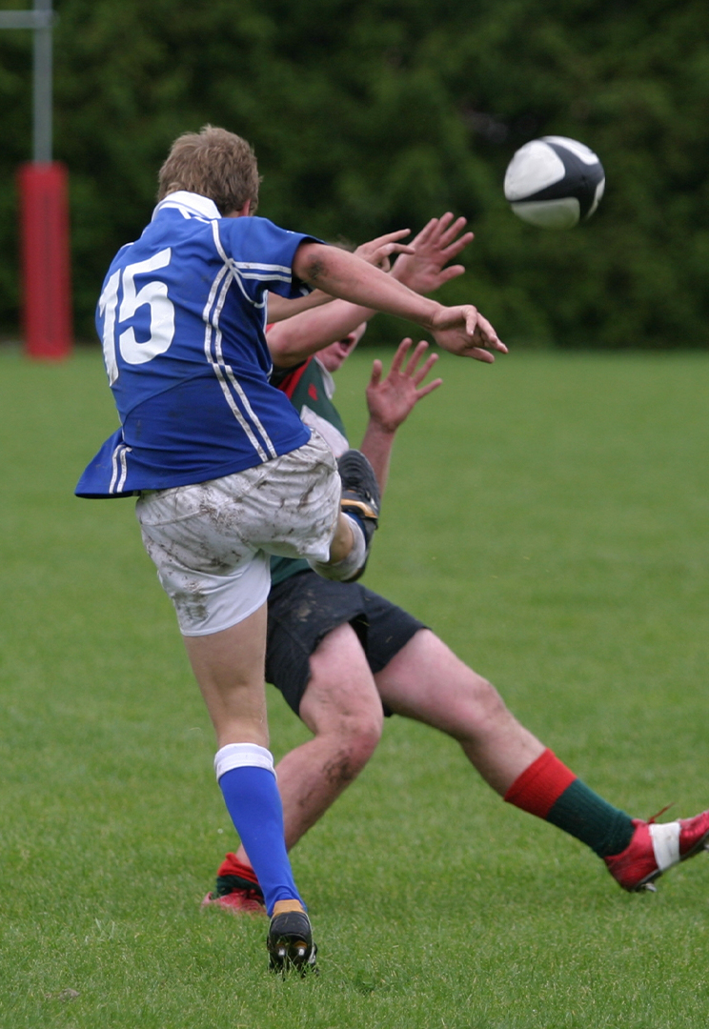
What if we do not develop these couplings?
Start to get movements occurring that do not take advantage of constraints
Likely to be less skillful
Less functional variability

Slide 20
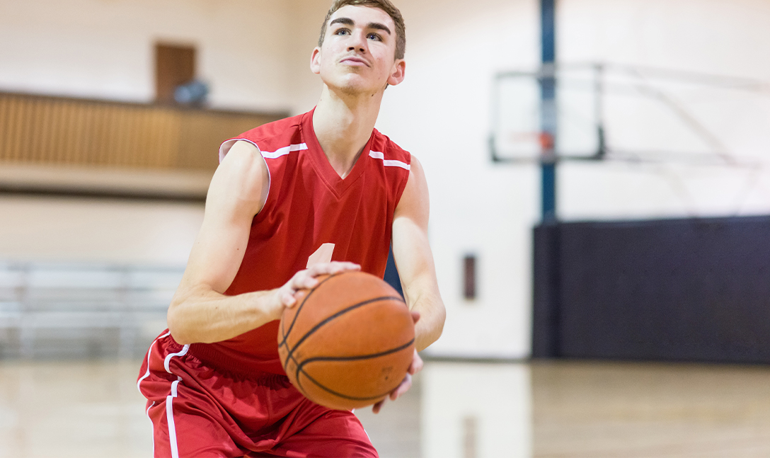
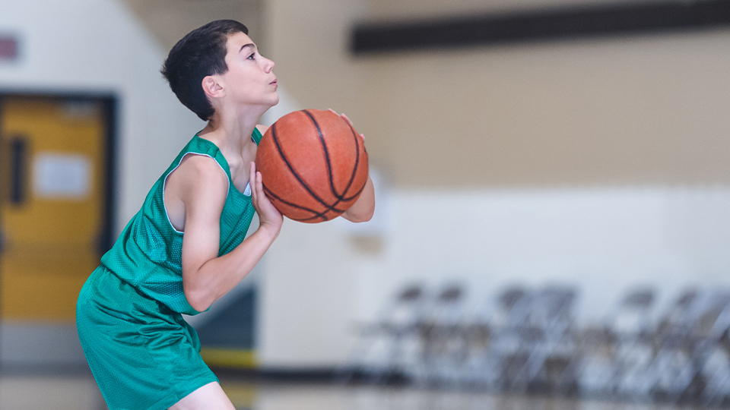
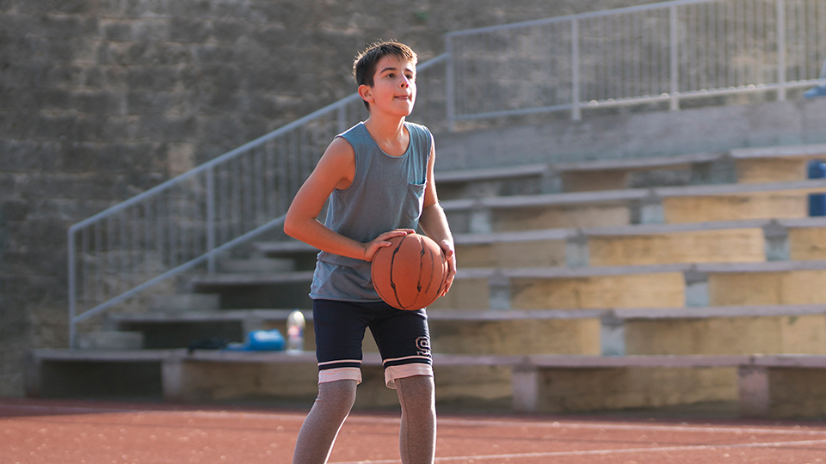
How do we have functional variability?

Slide 21
Where to start…
Key question, what is the movement(s) or skills that you are trying to get the player to either do more often or learn? Hard but crucial question!
What is the coupling you need players to learn, eg in badminton is someone is at the net, then look to hit the shuttle over their head to the gap at the back

Slide 22
If learning is about transfer (and retention) – what helps achieve this?
Learning functional coupling
Transfer from previous experiences
Practice environment needs simulates key constraints in the performance environment.
Not all of them, all of the time. No need to ’play the actual game’ all the time. But which couplings are you purposefully keeping or excluding and when and why do you do this? Ie static defenders to more defenders than attackers.

Slide 23
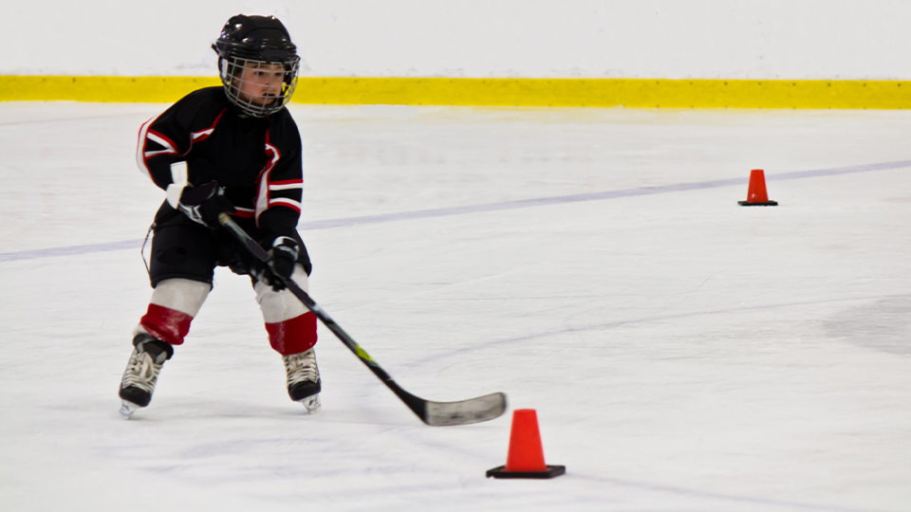
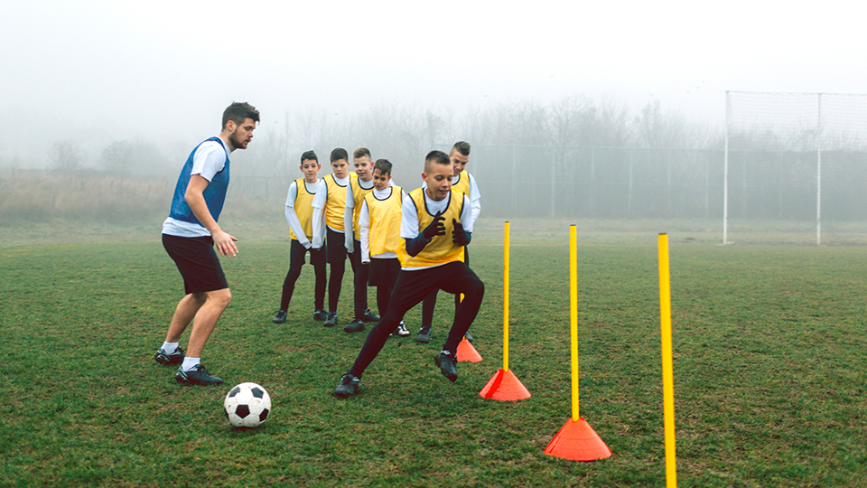
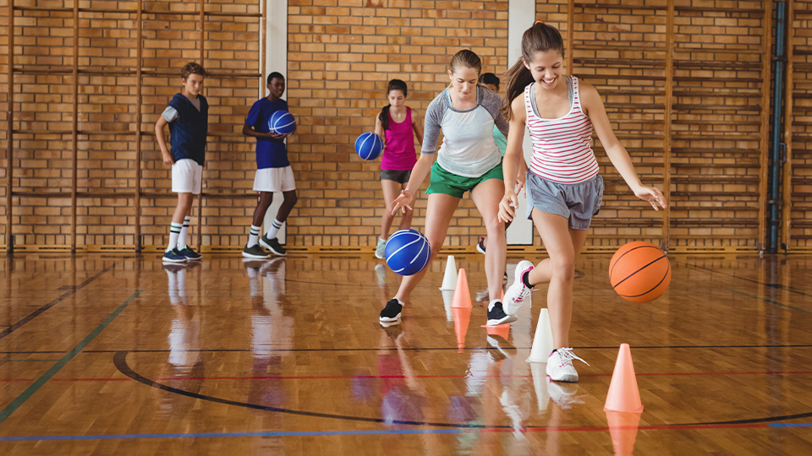
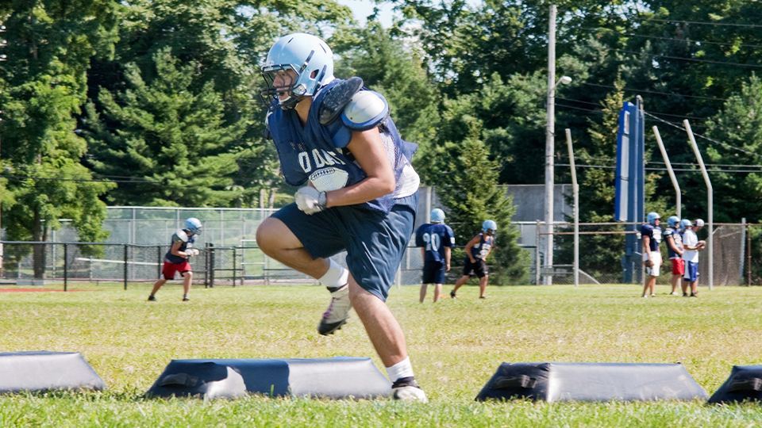
What is wrong with these activities?

Slide 24
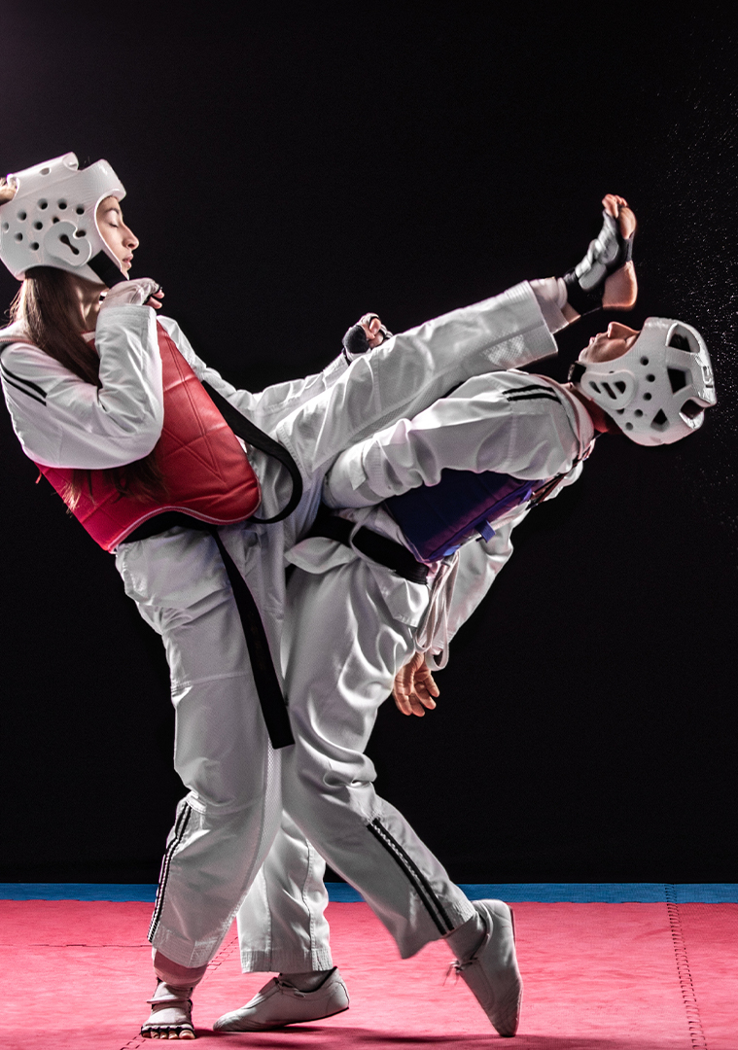
Keeping key info in the practice environment
What is key in your sport??

Slide 25
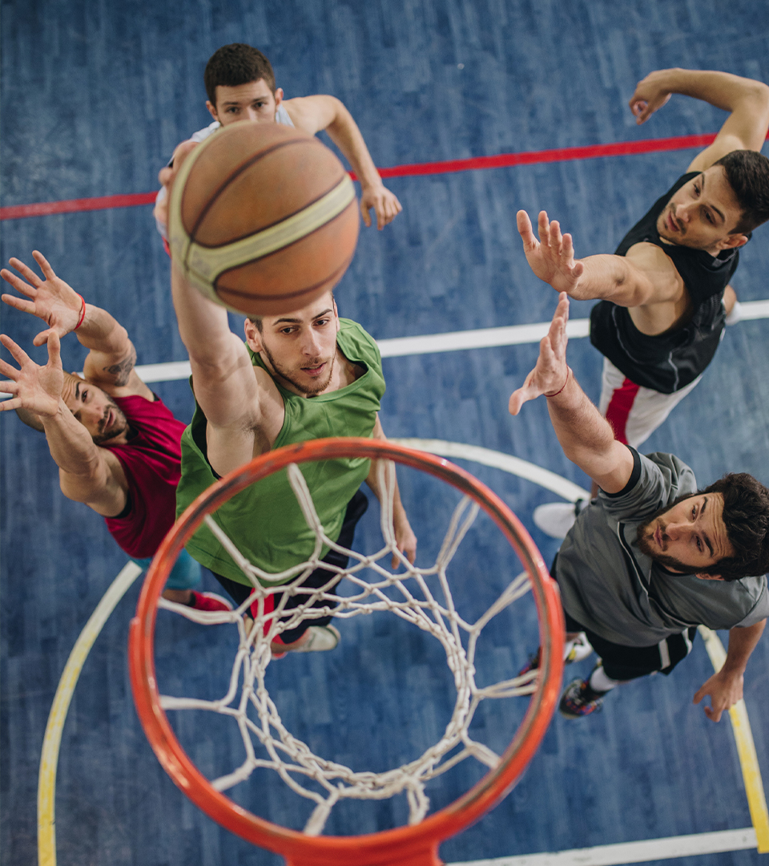
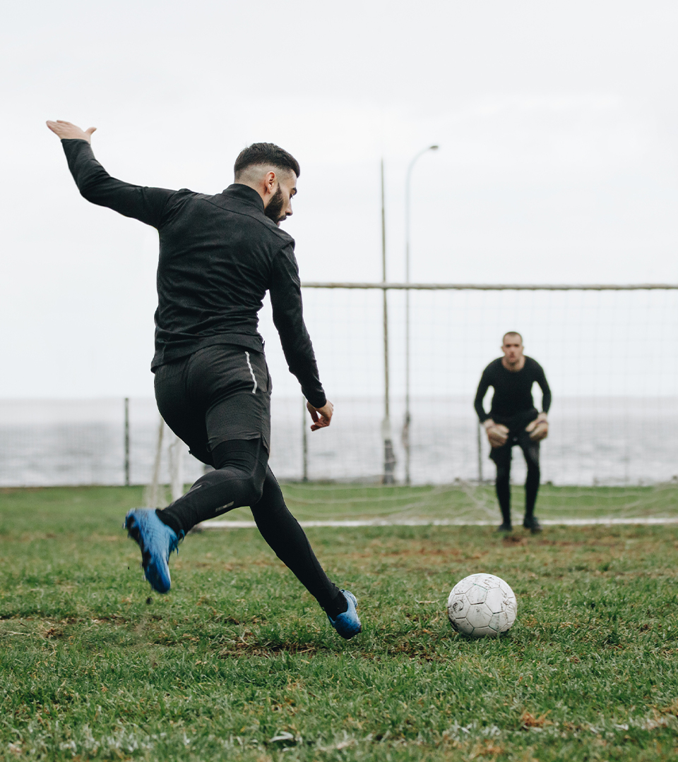
What are some practice activities that keep this key info included?

Slide 26
Planning for learning
Key information keep in the practice environment
Variability
Key conditions
Progressions – start with achievable activities that promote movement and especially exploring options (language and tasks are key here).
Exploring is key; but so is the stage when both the new and an old movement feel similar; athletes need encouragement and allowed mistakes
If repeating the same movement, change something…

