Slide 1
Welcome to Green Impact!

Slide 2
What is Green Impact?
What is Green Impact?
Green Impact is a change and engagement program. Which is a fancy way of saying that it’s a program designed to help and guide staff and students, from all different backgrounds and interest levels in sustainability and environmental issues, to make real and positive changes in your homes and workspace. Together you can help make AUT a healthier and more sustainable place to work and live. The program recognises that changes, no matter how small, can add up to make a real difference.
Teams Community of change makers
Toolkit Guidance on actions to take
Monitoring Instant feedback & audits to show progress
Awards Celebrate successes & get recognised

Slide 3
What is Green Impact?
How does it work?
Individuals form teams with peers and work together to undertake a diverse range of sustainability actions. These actions cover all areas of sustainability– i.e. travel, waste, wellbeing, diversity etc. and have been created specifically for you by your Sustainability Team. These actions are available for you to select from an interactive online list called your toolkit. Towards the end of the program cycle, we will train a group of enthusiastic student volunteers as “auditors”, who will then visit teams to verify the actions they have completed throughout the program. The program wraps up when we get together as a group to celebrate our collective achievements at an awards event at the end of the year. That’s the super quick overview, so if you’re still a little unclear on how it all works, don’t worry! We will go into more detail on how it all works during this presentation.
Who can take part?
Any member of staff and all students at AUT can participate in this program. However, Green Impact is not really for individuals, it’s designed to be undertaken as part of a team of people, so they can get together, share the responsibility (and fun!) and take part as a group. Ideally members with a team will be located in the same geographical area, for example, in the same office or a floor of a building. The program uses friendly competition to motivate teams, and we’ll learn more about how that works later on.

Slide 4
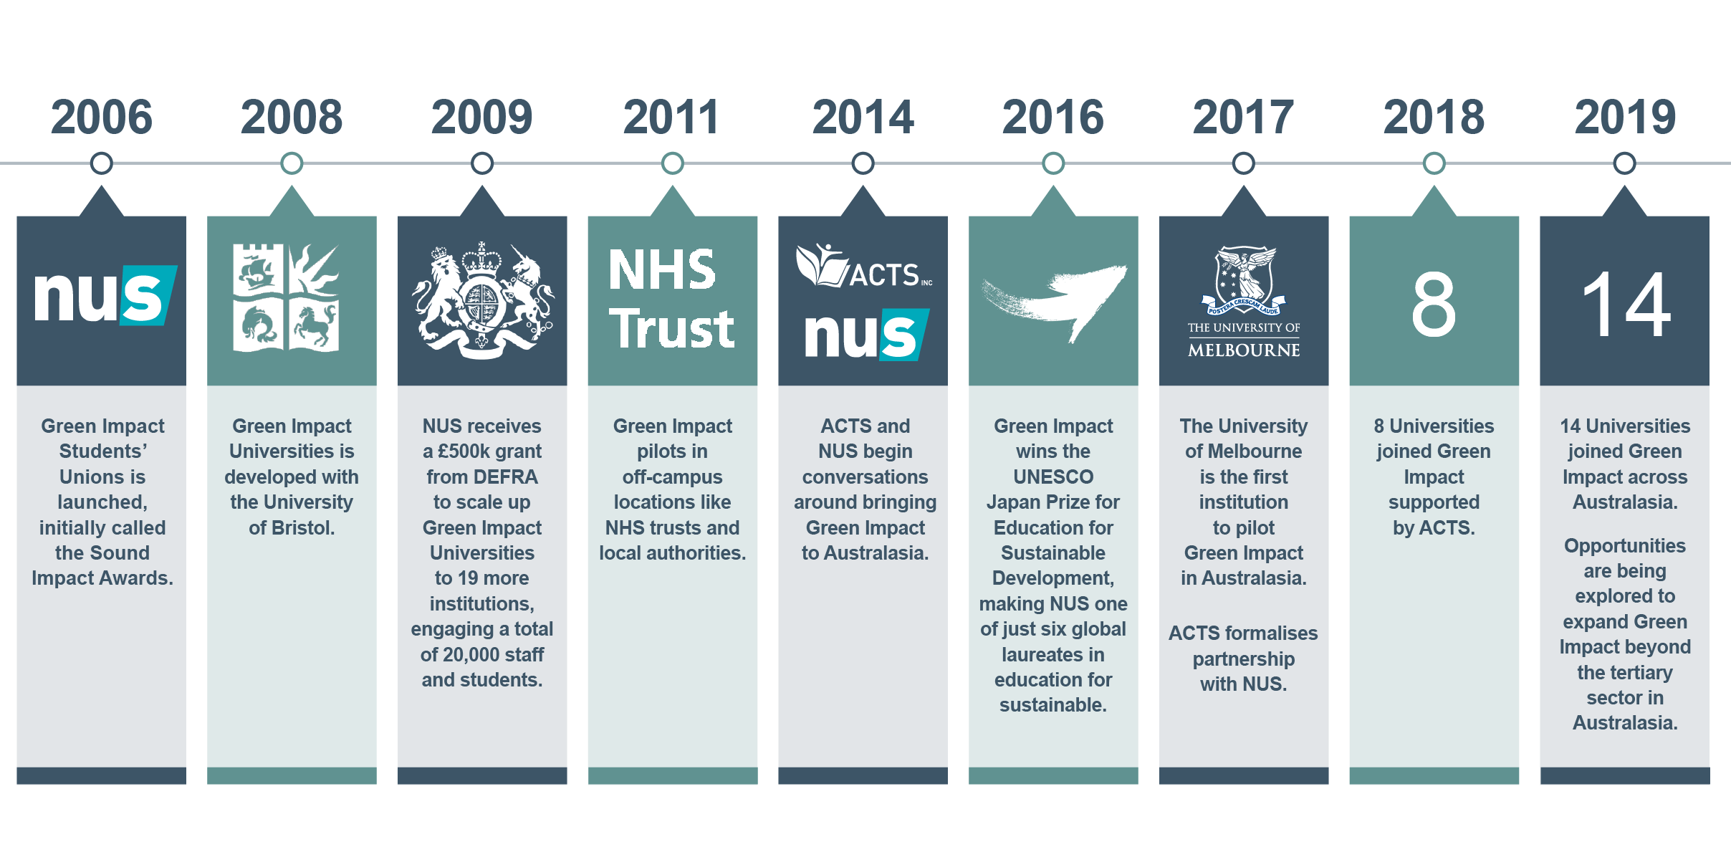
An ever-evolving program

Slide 5
An ever-evolving program
How did the program come about?
Green Impact was first developed by the National Union of Students (NUS) in the United Kingdom in 2006. The program was initially developed by students in the student unions, before being rolled out to staff within universities. After it’s success within the university sector, the program has adapted for a range of cross sector organisations, such as councils, schools, fire stations and hospitals.
In the 12 years it has been running Green Impact has been a massive success. It is now Internationally recognised with participants in Belgium, Holland and Canada, and currently experiencing the biggest growth here in Australasia. In 2016 Green Impact was recognised with the UNESCO-Japan Prize on Education for Sustainable Development.
Growing across Australasia
Australasian Campuses Towards Sustainability (ACTS) broadened the program’s reach in Australia and New Zealand. By the end of 2017 ACTS had formed a unique partnership with the NUS to become the delivery partner for Green Impact in Australasia. In 2018, eight universities piloted the program, and that has grown to 15 universities in 2020! We are delighted to be a part of this sustainability engagement movement with our fellow universities.

Slide 6
Delivered locally, supported globally
Australasian delivery partner for Green Impact
greenimpact.acts.asn.au
Founder of Green Impact
greenimpact.nus.org.uk

Slide 7
You’re part of a global movement
4 Universities across Europe this year!
65 Student unions
40 Universities & Colleges
120 Businesses, hospitals & councils
1
Canadian University; working to deliver across the USA
15 Universities in Australasia and counting!
Over 4,500 teams to date across nearly 500 organisations implementing over 350,000 greening actions!

Slide 8
Every action - no matter how small - counts
476
375,000
actions taken
222,987 as a direct result of Green Impact
476
Organisations
Organisations
Organisational & international recognition
37,522
4,596 teams taking part
Over 4,680 students trained
People have lead GI teams
Staff reach 159,000

Slide 9
2020 Green Impact Institutions

Slide 10
Program cycle
Awards Event
Audits by Student Auditors
9th September
Ongoing Support
Team Recruitment
Planning & Toolkit Development
February-April
Feedback & Evaluation
Toolkit Submission
2nd September
Green Impact is based on a model of continuous improvement…

Slide 11
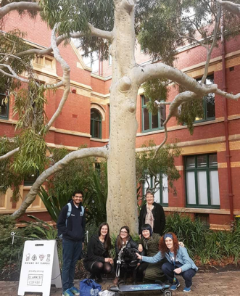
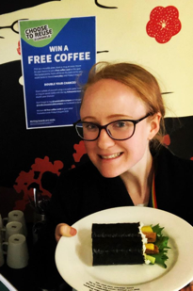
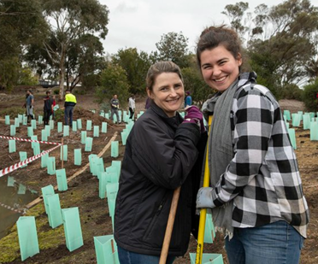
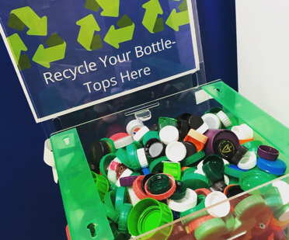
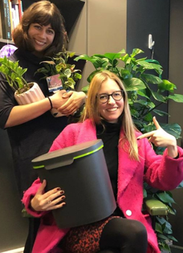
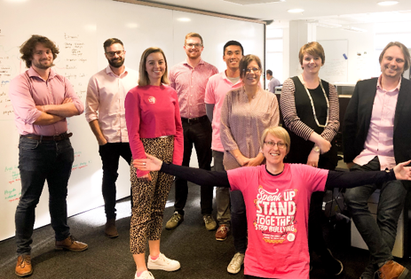
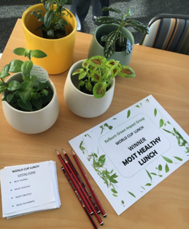
Green Impact covers ALL areas of sustainability

Slide 12
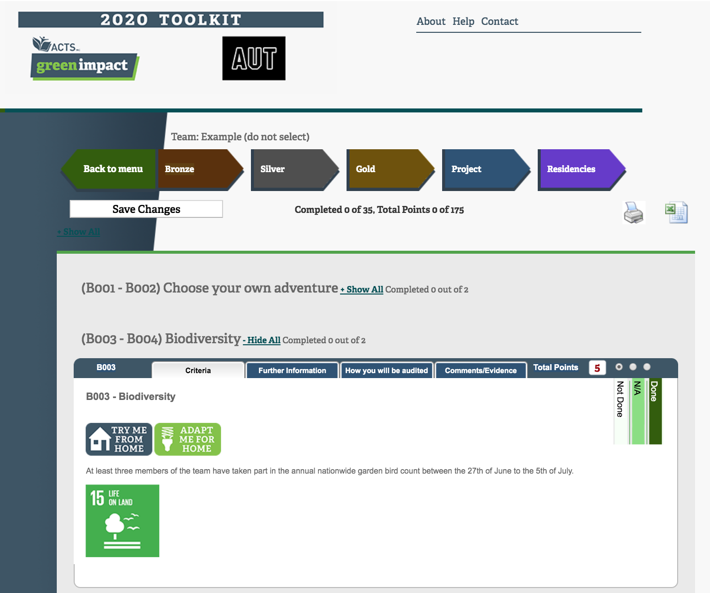
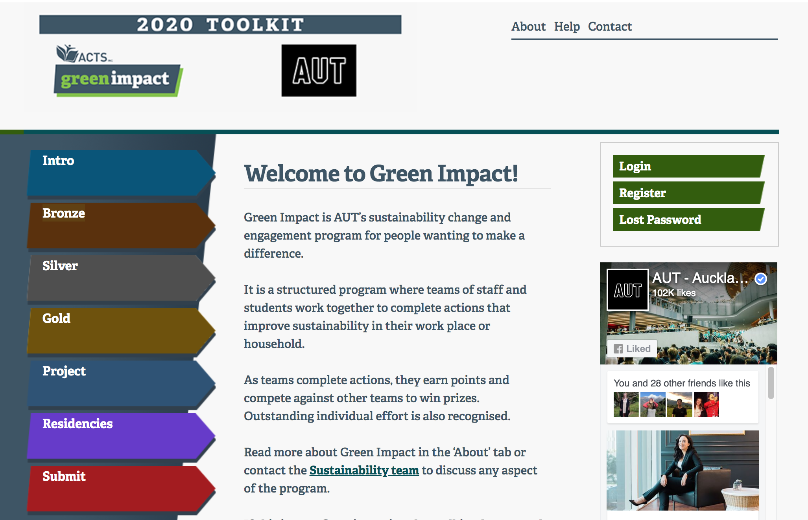
Bespoke online toolkit

Slide 13
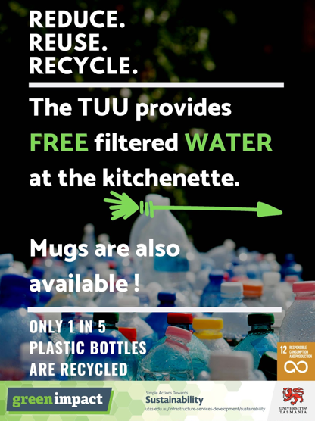
Actions in action!
“The team has encouraged staff in their area to take a reusable container or cup when they order takeaway”
UTAS: Rural Clinical School (2019)
Supporting:
Responsible consumption
Reduced waste to landfill
Notes:
Common examples of toolkit actions

Slide 14
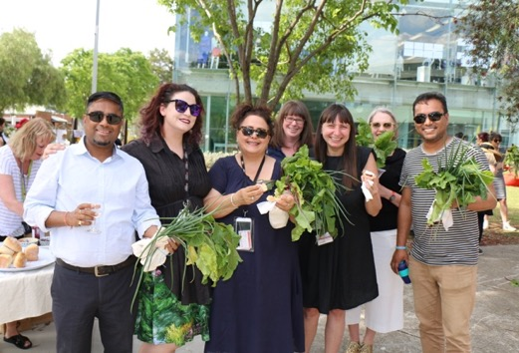
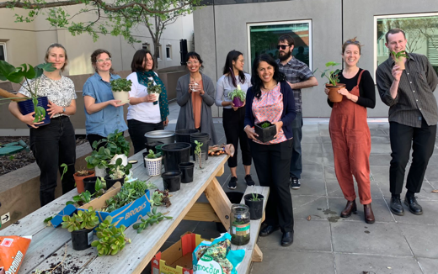
Actions in action!
RMIT: The Composters (2019)
“The team attends a working bee, gardening or potting workshop to learn about composting, soil and plants"
Supporting:
Biodiversity
Urban green spaces
Health & wellbeing
Uni of Melb: GPS Melbourne (2019)
Notes:
Common examples of toolkit actions

Slide 15
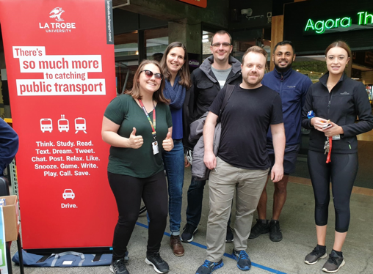
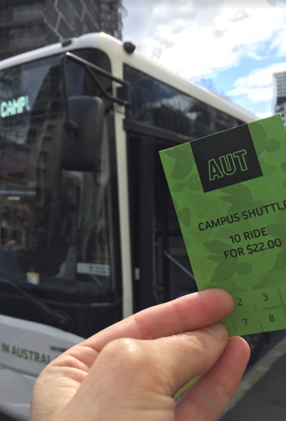
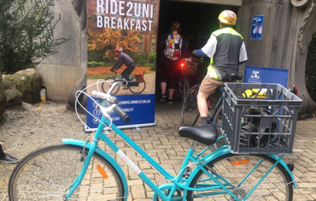
Actions in action!
“The team has encouraged staff in their department to use sustainable transport options to get to work”
La Trobe: Snapping Turtles (2019)
Supporting:
Sustainable transport
Reduce carbon emissions
AUT:
The Greenarians (2019)
Notes:
Common examples of toolkit actions

Slide 16
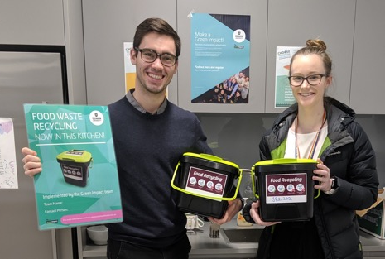
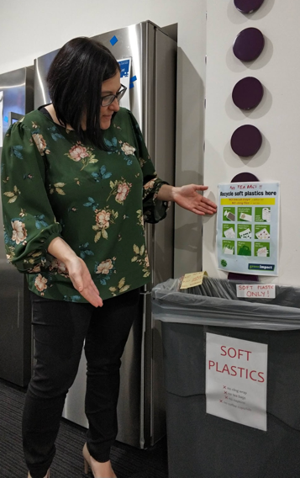
Actions in action!
“The team has set up collection stations, for specific materials, for recycling. These could include but are not limited to: soft plastics, organics, e-waste, batteries, coffee pods and bottle caps”
Deakin University (2019)
Supporting:
Increased recycling
Reduced waste to landfill
Uni of Adelaide:
The Evergreens (2019)
Notes:
Common examples of toolkit actions

Slide 17
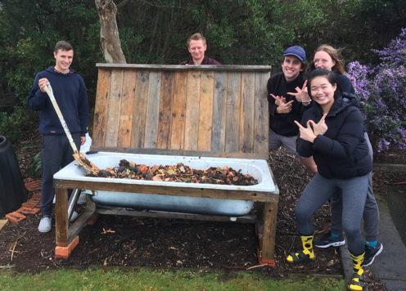
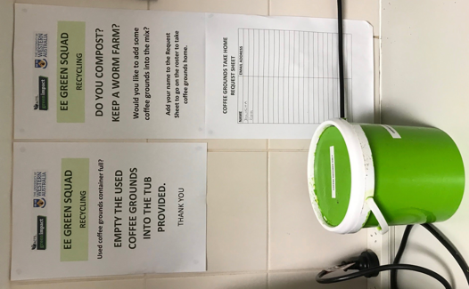
Actions in action!
“The team has existing composting / worm farm facilities or has started the process of creating a communal compost facility within their department”
UTAS: Rural Clinical School (2019)
Supporting:
Reduced food waste
Reduced waste to landfill
UWA:
EE Green Squad (2019)
Notes:
Common examples of toolkit actions

Slide 18
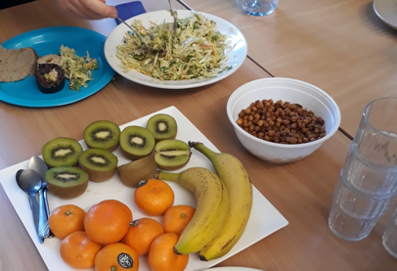
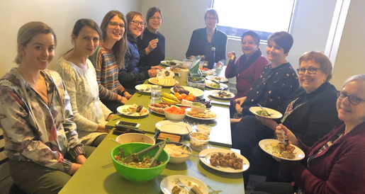
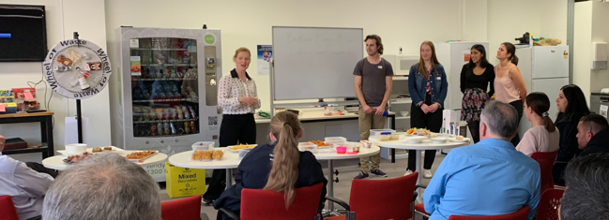
Actions in action!
“The team has hosted a healthy, plastic free morning tea”
VUW: Green ME (2019)
VUW: Team Amazonica (2019)
Uni Melb: Bedford Busy Bees (2019)
Supporting:
Health & wellbeing
Sustainable consumption
Reduced waste to landfill
Notes:
Common examples of toolkit actions

Slide 19
Live dashboard of progress

Slide 20
Live dashboard of progress
The Achievement Report
The Achievement Report is a fantastic resource in your online toolkit. It not only provides you with a snapshot of how your team is progressing in the program, but also tells you what AUT has collectively achieved to date. It also tells you what has been achieved globally across all participating organisations this year.
A common barrier for engaging people to undertake sustainability actions is a misperception that their small actions “won’t make a difference”. This achievement report demonstrates that EVERY ACTION actually does make a difference, as part of a global community of people taking action! If Green Impact teams are only able to complete one or two actions in their toolkit, that is still something to be celebrated and rewarded – and Green Impact recognises these contributions.
The League Table
The league table provides a light competitive element to the program. The table displays the top 10 performing teams, and can be based on either number of points earned.

Slide 21
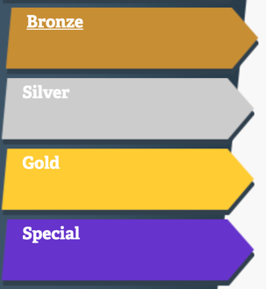
The toolkit: top tips!
Stuck on an action? Check out ‘further information’, and ‘how you will be audited’ to make comments to keep track of progress
Contact details for help are in the footer
Remember the Special Awards tab
All editing functions can be done through the ‘Profile’ button
Simple and manageable
Slightly more challenging
Most challenging actions
Teams nominate people or projects for special awards such as ‘Engagement Innovators’

Slide 22
Scoring for team awards
Points per action or project
Action type | Action value
Bronze | 5 points
Silver | 10 points
Gold | 15 points
Certificates and points
Certificates | Points required
Working towards Bronze | Less than 75 points
Bronze | 75 points
Silver | 150 points
Gold | 185 points
Each action is assigned a point value, to receive a silver certificate for example your points must total or exceed 125. You can do any actions whether bronze, silver or gold to reach this total.

Slide 23
Why do we audit in Green Impact?
The Green Impact audits is a supportive process to give credibility to the work you’ve done so you can feel proud of your award, as well as…
Providing you with ideas for improvements
Gathering best practice from across the university
Identifying common challenges
Informing program development
We’re not there to catch you out, and the student auditors will be fully trained to ensure they conduct the visit in a positive, friendly manner.

Slide 24
Why we audit in Green Impact
Brings students into the heart of the program
Helps record continual improvement
Encourages action and good practice

Slide 25
Recognising excellence!
Overall Winner
Award levels are based on number of actions completed, however there are also points allocated for each of the actions. The easiest actions have a small amount of points allocated, whilst hard and more time-consuming actions have a high points value. The team that scores the highest amount of points after the audits will be recognised as the overall winner for the 2021 program.

Slide 26
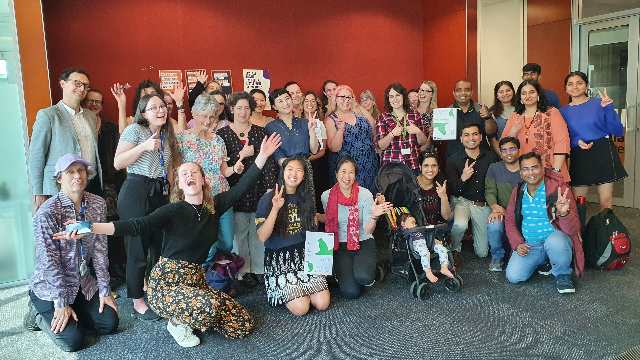

Slide 27
We are here to help!
Keen to get involved?
Sign up with your team here! https://www.greenimpact.org.uk/aut
Want some more information?
Email sustainability@aut.ac.nz
Staff can visit AUTI and students, the Student website. Visit greenimpact.acts.asn.au for more on the wider program.
Share your stories!
#GreenImpactAUNZ #GreenImpact

