Slide 1
A Modern Learning Environment For Pre-beginner Adult ESOL Learners
Possibility and Collaboration Combine in the Transition Stage
Notes:
Click on link for musical intro while people are entering.
Introduce selves and the topic.

Slide 2
Innovative Learning Environment How Can We Adapt?
MLE Spaces:
Open
Flexible
Access to resources
ILE Methods:
Personalised
Differentiated
Connected to real world
Socially constructed
Inquiry-Based Learning
Adapted from Osborne, M.
Literacy level learners:
Collectivist cultures
Unused to western learning styles
Little/no formal education
Mostly no prior technology use
Notes:
Penny
Definition of socially constructed: 3. Recent developments and trends in education • From constructivism to social constructivism Constructivist approaches are now also making way for social constructivism. Communities of Practice (COPs) are evolving and beginning to play a significant role in teaching and learning environments. The focus is on the effective and productive use of existing, social and natural resources for learning. The real expert is not the teacher, or any other person for that matter, but the community of practice. Constructivism refers to learning as the construction of new meanings (knowledge) by the learner him/herself. Social constructivism refers to learning as the result of active participation in a ‘community’ where new meanings are co-constructed by the learner and his/her ‘community’ and knowledge is the result of consensus (Gruender, 1996; Savery & Duffy, 1995). Cited in Brown (2005)
http://www.bucks.edu/old_docs/academics/facultywebresources/Beyond_constructivism.pdf
An example of socially constructed learning in our case: would be when learners are given the resources to play a game: plastic vegetables, fake money, paper and pens. The teacher might suggest what to do and offer guidance, but allows the group to make up the prices and rules and adapt the conversation to fit the prices and rules. It is not learners working together in a group to achieve a preordained result, but working with the resources given to negotiate meaning together, so that different groups will achieve different outcomes. The expert is not the teacher, nor any one person, but the Community of Practice.
Definition of Inquiry Based Learning:Inquiry-Based Learning
Educators committed to IBL provide learning experiences that are open-ended, promoting student choice in a collaborative environment. Teachers engage students by helping them pose their own questions and guide their learning to seek answers. IBL provides opportunities to celebrate students' insights and growth, especially when teachers participate as guides and learners alongside their students (Mills et al., 2004; Mills, O'Keefe & Stephens, 1992). Given these foci, IBL is particularly geared toward engaging students in asking questions, debating ideas, making predictions, designing plans and/or experiments, collecting and analyzing data, drawing conclusions, communicating ideas and findings, asking new questions, and creating artifacts (Blumenfeld et al., 1991). Values consistent with IBL include creating a high-performance learning environment with real-life contexts and technology (Boss, 2012). Cited in Steeg et al (2013)
An example of this in our context: would be the way we have gone about creating an MLE. We tried to define an MLE, asked questions about how it applied in our context, we predicted how learners would cope and react to the new ways of teaching and learning, we designed lessons as experiments, collected data as videos, analysed it, drew conclusions, asked new questions, communicated our ideas to other teachers who asked new questions and so on….
Another example: Ask peer tutors what questions they are asked in their own language i.e. questions which the students could not ask their classroom teachers.
Another example: Tell students will be given $3 each to spend on ingredients for lunch. This will cover everything except meat or fish. They plan a meal, predict prices, find out how to ask for their ingredients, ask about prices and availability, enquire about halal, look at prices in shop, draw conclusions, communicate information to each other and teacher, ask “what if” questions, (e.g. “What if we put the bag of garlic back and buy one bulb of garlic?” “What if we buy half the amount of potatoes?”), purchase food and create a meal. Values consistent with IBL include creating a high-performance learning environment with real-life contexts and technology (Boss, 2012). Cited in Steeg et al (2013)
An example of this in our context would be post-intermediate level learners being shown a map and photos of New Zealand and being encouraged to ask questions, then selecting questions they would like to know more about by predicting what will be useful, planning a way to find out more, collating data and drawing conclusions about it, telling another group about their findings and eliciting more questions; finally creating an informative brochure.
Introduction. We both teach literacy level adult refugees at Mangere Refugee Resettlement Centre. Last year we were asked to trial an MLE as part of our preparation for the rebuild of our school.
We looked at MLEs in operation at Stonefields Primary and Hobsonville Point Secondary schools. They both have environments which they describe as open, flexible and offer access to resources. Their buildings, however, are purpose built and their technology is abundant. In our own situation we were going to throw open the dividers between two old classrooms and we had 16 new iPads to be shared between 8 classes. So that is the MLE. The ILE on the other hand: In order to work together and create this new teaching environment we have had many conversations. You can imagine one of them going something like this:
Man Hau, how are we going to structure an ILE? Socially constructed learning and Inquiry Based Learning seem incongruous with low level literacy. Most of our learners come from very traditional educational backgrounds with few resources. Many have never been in a classroom before and have no literacy in their own language. Even walking into our classroom for the first time seems to make them feel very self conscious. Man Hau, how can we use these open spaces? How can we teach our learners to be flexible? How can we teach them to access resources they have never used before independently of us?
Well Penny, maybe we have to look at their strengths and what they say they need and want. Let’s see if we can provide it in this larger, more flexible classroom. For example, most of our learners come from collectivist cultures. That may mean that the collaborative style of learning which is common in an ILE will suit them well.
So, this conversation we have just had is a summary of many conversations we have had just to give you an idea of how we have gone about finding ways to develop an ILE. The context for us was very different from what we had seen in ILEs so far. It was up to us to find ways to use the ILE to enhance both teaching and learning in our classroom.
-----------------------------------------------------------------------------------------------------------------------------------------------------------------
It is well documented that refugee-background students have difficulty in adapting to western and independent learning styles, so perhaps we would have an opportunity to use the ILE flexibility to better acknowledge the collectivist cultures of most of our learners and promote collectivist learning through collaboration and socially constructed learning.
We saw the school visits as providing inspiration to change, but change to what we were still unsure. I was fairly new to working at the literacy
http://mle.education.govt.nz/home/case-studies/ citation above: “major shifts in the use of technologies and the way students are learning”
http://www.core-ed.org/sites/core-ed.org/files/Modern-Learning-Environments-v.1.pdf
What we know about learning has increased dramatically over the last 20 years. MRI scanning that allows us to see inside the brain as learning occurs, and landmark studies such as John Hattie’s Visible Learning (Hattie, 2008) mean that we now have a much better idea of how learning occurs. As a result of these developments and others, we know that quality learning is a combination of the following elements:
● Personalised learning: no two individuals learn in the same way, nor do they bring the same prior knowledge to a learning experience. The way we learn is as unique as our fingerprint.
● Socially constructed learning (Johnson, 1981): the collaboration, peer-tutoring and reciprocal teaching that occurs when students work together results in a deeper understanding of the material being covered.
● Differentiated learning (Bloom, 1974): the prior knowledge we all bring to a task means individuals require different levels of challenge, pace, content and context.
● Learning that is initiated by students themselves (Ramey & Ramey, 2004): typically when a student initiates a learning experience or exploration, they learn more.
● Learning that is connected to the physical world and authentic contexts: children learn through interaction with others and the physical world (Malone & Tranter, 2003). Learning about pond ecosystems is more powerful if students visit a pond in addition to learning about them in a classroom or textbook.
References Bloom, Benjamin S. "An introduction to mastery learning theory." Schools, society and mastery learning (1974): 3-14.
Functional Magnetic Resonance Imaging (http://en.wikipedia.org/wiki/Functional_magnetic_resonance_imaging)
Hattie, John. Visible learning: A synthesis of over 800 meta-analyses relating to achievement. Routledge, 2008.
Johnson, David W., et al. "Effects of cooperative, competitive, and individualistic goal structures on achievement: A meta-analysis." Psychological Bulletin; Psychological Bulletin 89.1 (1981): 47.
Malone, Karen & Tranter, Paul. “Children's Environmental Learning and the Use, Design and Management of Schoolgrounds.” Children, Youth and Environments 13(2), 2003. Retrieved March 2013 from http://colorado.edu/journals/cye March 2013.
Ramey, Craig T., & Ramey, Sharon L. “How Children Learn And How Parents Can Help”. Retrieved from the web http://www.cdl.org/resource-library/pdf/how-children-learn.pdf , 2004 level with ESOL learners so reading about best practice in this area was a good place to start.

Slide 3
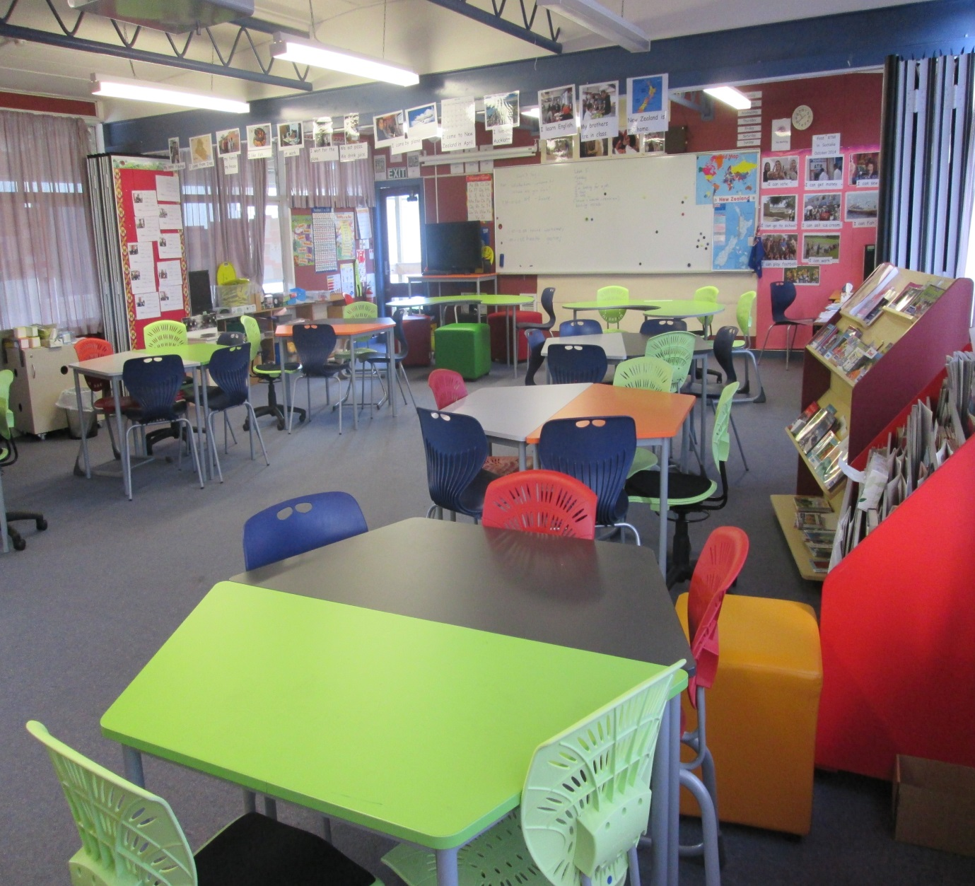
Modern Learning Environment
E

Slide 4
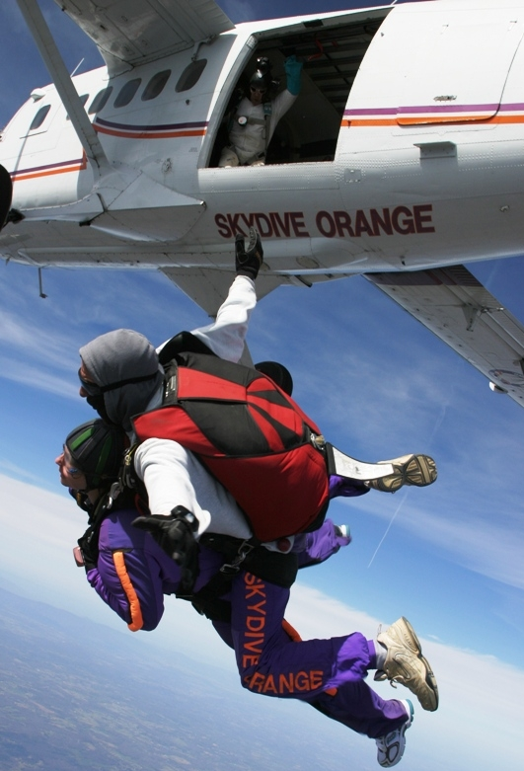
Team Teaching
“two or more individuals with complementary skills interacting to create a shared understanding that none had previously possessed or could have come to on their own.”
Schrage’s definition (as cited in Montiel-Overall, 2005)
http://openlearningspaces.blogspot.co.nz/2011/10/collaborative-teaching-what-might-it.html
Notes:
Penny
Planning together and team teaching is a fundamental requirement in an ILE so it seems appropriate to start here. There are many texts on team teaching. To get you started you might look up Chris Bradbeer’s blogspot: http://openlearningspaces.blogspot.co.nz/2011/10/collaborative-teaching-what-might-it.html
Or you can jump out of a plane together to see how it feels when you are starting out.
I can identify with Schrage’s definition of team teaching: the important words here are “complementary skills” and “interacting to create a shared understanding” and “noone…could have come to on their own”. That is what makes working in an ILE so exciting. Man Hau and I have come together with two very different philosophies which are complementary. So you don’t have to have identical philosophies to work well together but you do have to have respect for each other.
To tell the truth, in our first lesson we didn’t even open the door of the plane, let alone open our parachutes. We sat tight with our seatbelts fastened and we divided the class into two levels. Man Hau taught the lower level at one end of the classroom and I taught the higher level at the other. That was clearly not using the new space to enhance our teaching or the learning that was happening. We had no idea at that stage how we could incorporate group work into a literacy level class. However, we have made changes that have enabled this to occur. One teacher now does one on one assessments at the beginning of the intake while the other teaches the whole class. We now have a much clearer picture from the beginning of learners’ skills. It has enabled us to group and regroup depending on our aims and learner skills. Mohamed might be in group A for name and personal information writing, group B for reading, but in group E for numeracy. Learners help each other more and are operating at a realistic level for making progress. We use language groups for home language support initially to convey instructions and meaning before moving learners to new groups. So that we can say learning has been enhanced enormously by team teaching.
The two of us now plan lessons together and reflect together after lessons to adapt the following day’s lessons. When we are faced with challenges, collaborative problem solving becomes the catalyst for “new ideas and methods”. But our borders have opened (a politically relevant analogy) and we have collaborated with other teachers and their classes as well. We jump out of that plane with anyone who is willing to jump with us as you will see. We are happy to be experimental, but we consult research to incorporate best practice.

Slide 5
Research review
Roberts et al:
Learners want greater independence and control in contrast to the lack of control over their past lives
Integration into family networks and communities
Emotional support
Blaker and Hardman:
Bi-lingual tutors to bridge the gap…reduce the time needed to communicate effectively
Others recommend:
Translated materials
Benseman (2012)
Notes:
Man Hau
Benseman’s review of research in this area is particularly pertinent because he focuses on adult refugee learners with low level literacy in New Zealand. The research findings reported by Benseman have highlighted examples of best practice, many of which we were already incorporating into our teaching in a traditional classroom. However it also highlighted things we were not doing:
Penny, when I look at the “key strategies for success” in Benseman’s review of research I realise there are quite a few areas I haven’t had the resources to achieve up until now.
Yes, Man Hau, and they also reported that learners would like to experience more integration into their family networks and communities. We are in an ideal situation to achieve this. The families are close by and so is the wider refugee community. Let’s use the space to invite others in.
Sure, Penny, and what about bi-lingual tutors? Blaker and Hardman strongly advocate bi-lingual tutors to bridge the gap and reduce the time needed to communicate. We do not have the resources to provide more tutors. How can we facilitate bi-lingual tutoring?
And so, with the close contact we had during preparation and reflection time we started to produce ideas and our self-efficacy increased as a result of working together.

Slide 6
Challenges
Strategies recommended by research
Bi-lingual tutors and translated materials
Family and community networks
ILE problems
Academic learning skills
Wariness of other
cultures
Personal issues
Physical and emotional
Withdrawn from class by other agencies
Notes:
Man Hau
First, we had to overcome some challenges:
We wanted the ILE to enhance teaching and learning and find out ways this new environment could support some of the strategies recommended for literacy teaching which we had been unable to implement before. At the same time the ILE was causing new problems: How could our learners learn in a noisy classroom and with distractions from nearby groups engaging in something funny, musical or just interesting? How could learners with few academic learning skills and no English understand enough classroom instructions to work independently in groups? There were plenty of challenges and plenty of collaborative problem solving. We also had to deal with daily practical problems and personal physical and emotional issues – For that we would adapt activities for physical ability and make them safe and fun!
Have a conversation:
Man Hau: Do you remember Benseman’s review of research into low level literacy learners? How can we incorporate some of these strategies?
Penny: There is no funding for 5 bilingual tutors. But I was talking to Shona the other day and she said she would be willing to bring her intermediate level class into our classroom so that the intermediate students could work with someone who speaks their language.
Man Hau: That sounds interesting. What would we have to do make it work well? Let’s talk to Shona about it, but we will have to prepare a worksheet for her students explaining what we would like them to do and how we want them to do it.
Penny: Yes and Shona talked about preparing her students before the class and also giving them a writing framework after the class to get some feedback on how it went for them. I’ll see if Shona is free at 3:00.
As you can see, communication is key and we rarely stop doing it.
______________________________________________________________________________________________________________
And Findings suggest that stressors associated with war, civil unrest and forced migration are not synonymous with the development of disorders, and that traumatic stress does not necessarily render individuals unable to cope or thrive.
Cole, 1998 ; Kapreilian-Churchill, 1996, Kuterovac-Jagodic, 2003, Almqvist & Brandell-Forsberg, 1997, Kinzie, Sack, Angell, Manson, & Rath, 1986
Findings suggest that stressors associated with war, civil unrest and forced migration are not synonymous with the development of disorders, and that traumatic stress does not necessarily render individuals unable to cope or thrive.
Cole, 1998 ; Kapreilian-Churchill, 1996, Kuterovac-Jagodic, 2003, Almqvist & Brandell-Forsberg, 1997, Kinzie, Sack, Angell, Manson, & Rath, 1986

Slide 7
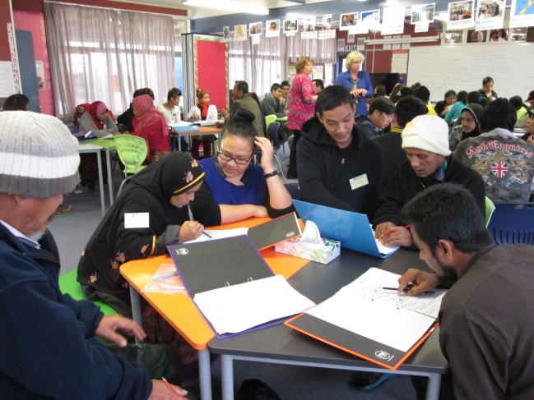
Notes:
Man Hau
This is what we wanted to achieve and did achieve…………….pair work, group work, learners working with resources to make meaning and use new language in creative ways.

Slide 8
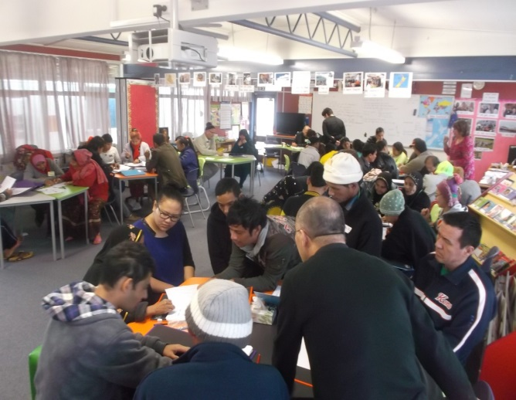
Peer Teaching (Kaiāwhina and Akonga)
“its power comes from the fact that barriers between teacher and learner are broken down.”
Auerbach, E. (1996) From the Community to the Community: A Guidebook for Participatory Literacy Training, Mahwah, NJ: Lawrence Erlbaum, pp. 9-12, 16-18
Notes:
Penny
During the half hour weekly session of peer teaching we can have up to 45 students in the room and 3 staff members. As soon as the Kaiāwhina walk in and Akonga are paired up with them the classroom is buzzing; look at the level of connection and engagement between the pairs in the photos and judge for yourselves.
We ask the Kaiāwhina to work on specific difficult concepts first and then do whatever the akonga want, transferring control to the akonga.
This bilingual teaching has enabled kaiāwhina to explain abstract concepts, teach culturally relevant learning skills and help learners feel more in control of their learning. It also provides ethno-specific emotional support in the classroom.
As Auerbach stated “its (bi-lingual teaching) power comes from the fact that barriers between teacher and learner are broken down.”

Slide 9
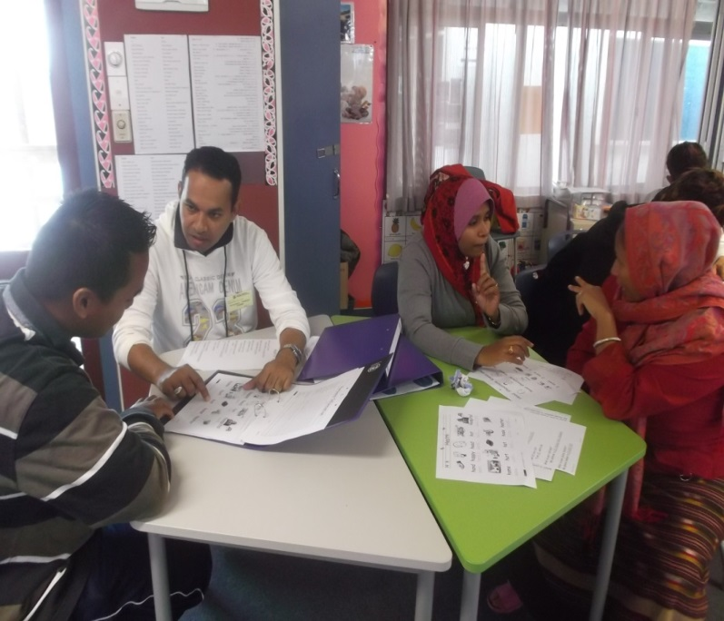

Slide 11
Akonga
“I can remember about 16 new words.”
“They speak our language.”
Kaiāwhina
“It was useful for me because the time repeated for me again.”
“give you great sense of helping and being useful to others.”
“I want to help my student in Hamilton too.”
Intermediate teacher
“overwhelmingly positive “
“feel useful where…they have felt disempowered”
“a very useful language exercise”
Notes:
Man Hau
We conducted a short survey on the peer teaching session with our literacy students. For this we used professional interpreters whom we have for half an hour a week. It was apparent from the answers that they thought they were learning during the session and they found it fun.
We asked akonga:What did you think of the peer teaching?
We asked Kaiāwhina in the intermediate class: Was it a worthwhile use of your time?
The teacher of the intermediate learners stated that her experience of the peer teaching was “overwhelmingly positive.” etc. The only negative expressed by students is that it is not always possible to have every student matched with someone who speaks their own language.

Slide 12
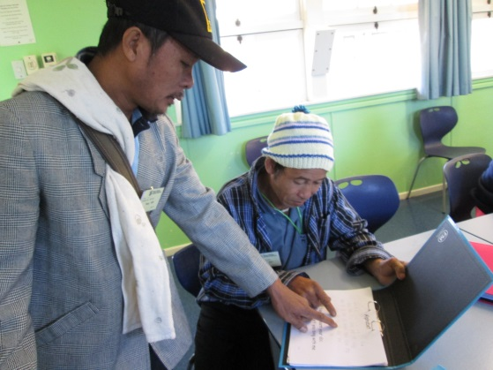

Slide 13
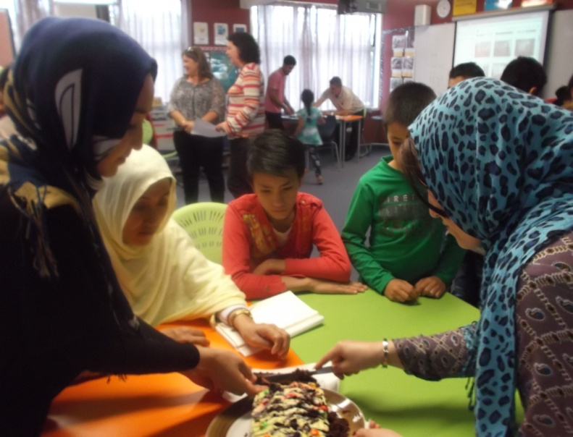
Whanau Literacy
Children and adults share cake, songs, videos
“We learnt that playing is learning.”
“We learn by living the experience.”
Notes:
Penny
The next big challenge was to incorporate further development of family and community networks into the programme.
To achieve this we collaborated with the primary classes.
We established a task for the adults to make chocolate cakes. Preparation for this task takes 2 days. On average 3 students out of 36 have ever baked a cake before or used an electric oven. In the afternoon of the second day the primary classes are invited to share songs the adults and children have learnt, videos recorded by the learners, and of course our cakes.
Gains from this activity are wide ranging and too many to mention:
We have observed intensive learning and teaching for this task as there is such a high level of excitement and anticipation.
We have also observed increased inter-generational learning outside the classroom afterwards.
A well known family literacy project known by its acronym MFLP was reported by UNESCO to have “helped them (parents) in their parenting skills and improved relationships with their children”. Our own adult learners stated that “We learnt that playing is learning” and “We learn by living the experience.
So, we have found that the flexibility of the environment and the collaboration of the teachers have enhanced learning and teaching.

Slide 14
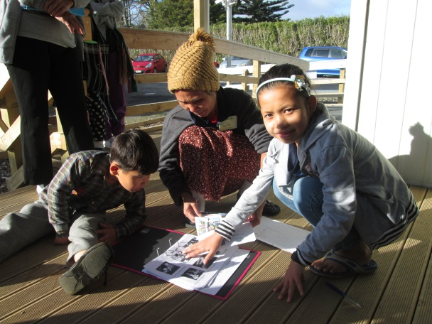

Slide 15
Technology – Digital Literacy
Mobile devices
iPad apps:
Alphabet
Numbers
Phonics
NZ currency
Sentence Builders
Topic vocabulary
LL English
Notes:
Man Hau
The MLE is not complete without the blending of technology into the programme. The iPads have helped with individualised learning. “A struggling reader may use text-to-speech (TTS) support” according to Grisham (2004) Immediate access to sound is like having teacher aides in the classroom. As can be seen here one student is working on the first consonant sound, the person next to them is clicking on individual scattered words and re-ordering them into a sentence. In these apps words or letter sounds can be listened to as many times as the user wishes; A third user at the same table might be practising the formation of letters of the alphabet. This is an example of highly individualised learning in action.

Slide 16
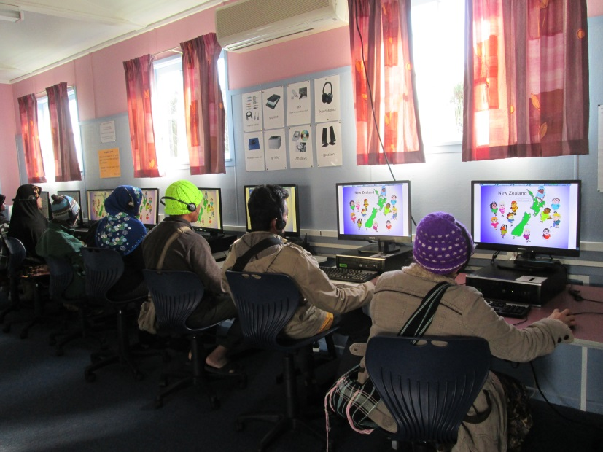
PCs

Slide 17
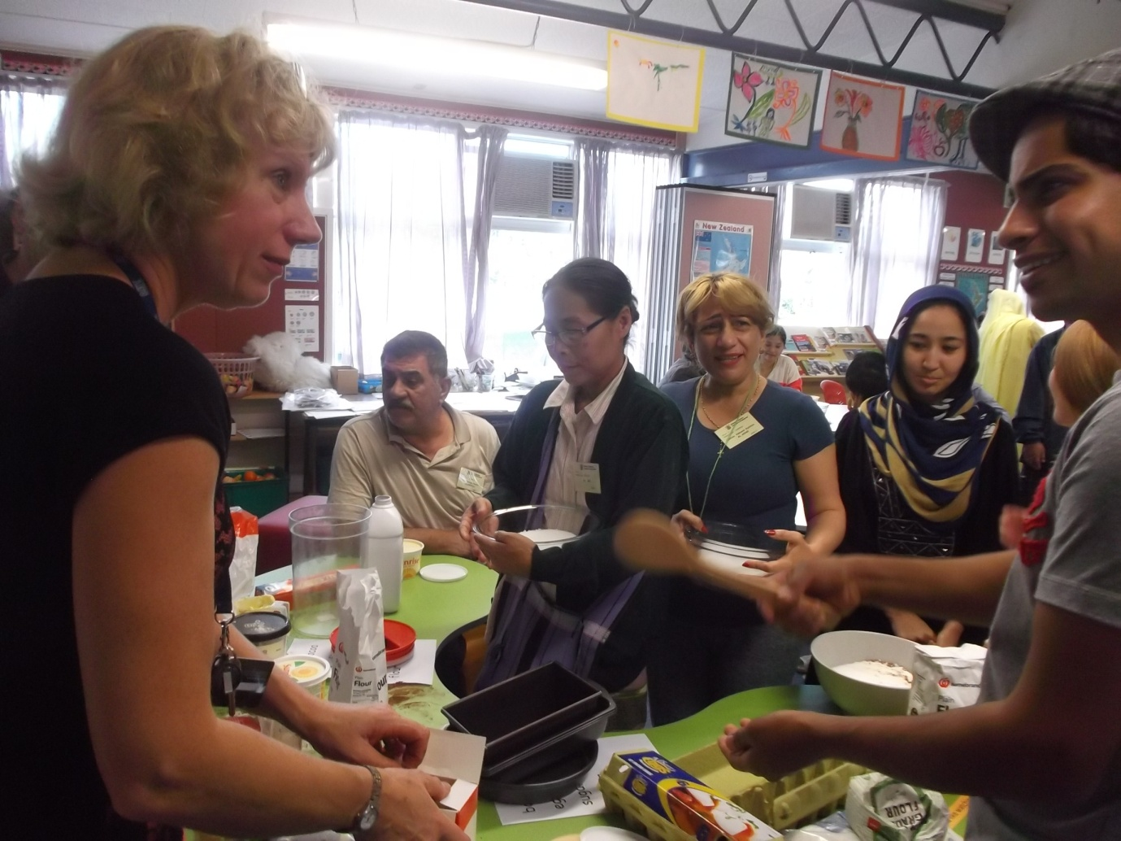
6 ‘C’s Collaboration Teachers, learners and classes
Notes:
Penny and Man Hau
What has the ILE afforded our literacy level ESOL programme: There is much more socially constructed learning: hands on activities where learners can observe others, be creative in their use of English in real situations and manipulate resources.
A recent article in the NZ Herald by Derek McCormack (2015) Vice Chancellor of AUT University reported that job candidates will be “passed over if an employer thinks they don’t have the “C-skills” ”. The 6 “C-skills” mentioned in the article are evident in our socially constructed learning.
Collaboration is happening in many areas. An example is the team planning which has been pivotal in enabling the teachers to create new initiatives.
Communication has increased in both L1 and English in this environment which is group and task oriented.
Cooperation has been encouraged to the point where people from different cultures are less wary of each other and more inclusive.
Curiosity in activities happening nearby stimulates vicarious learning.
Caring within the community has been initiated by the peer teaching programme and
Creativity is enhanced by group collaboration.
In summary we have been having lots of fun together and we are in no doubt that the ILE will continue to evolve and we hope our learners will help to decide on the direction.
There are other C’s worthy of mention: Man Hau:

Slide 18
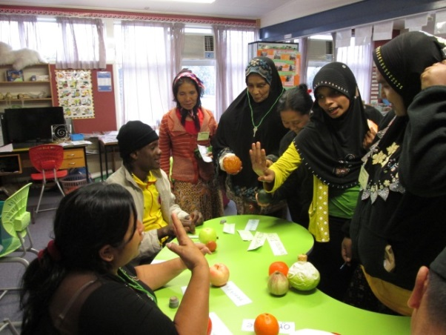
Communication To achieve common goals in L1 and English

Slide 19
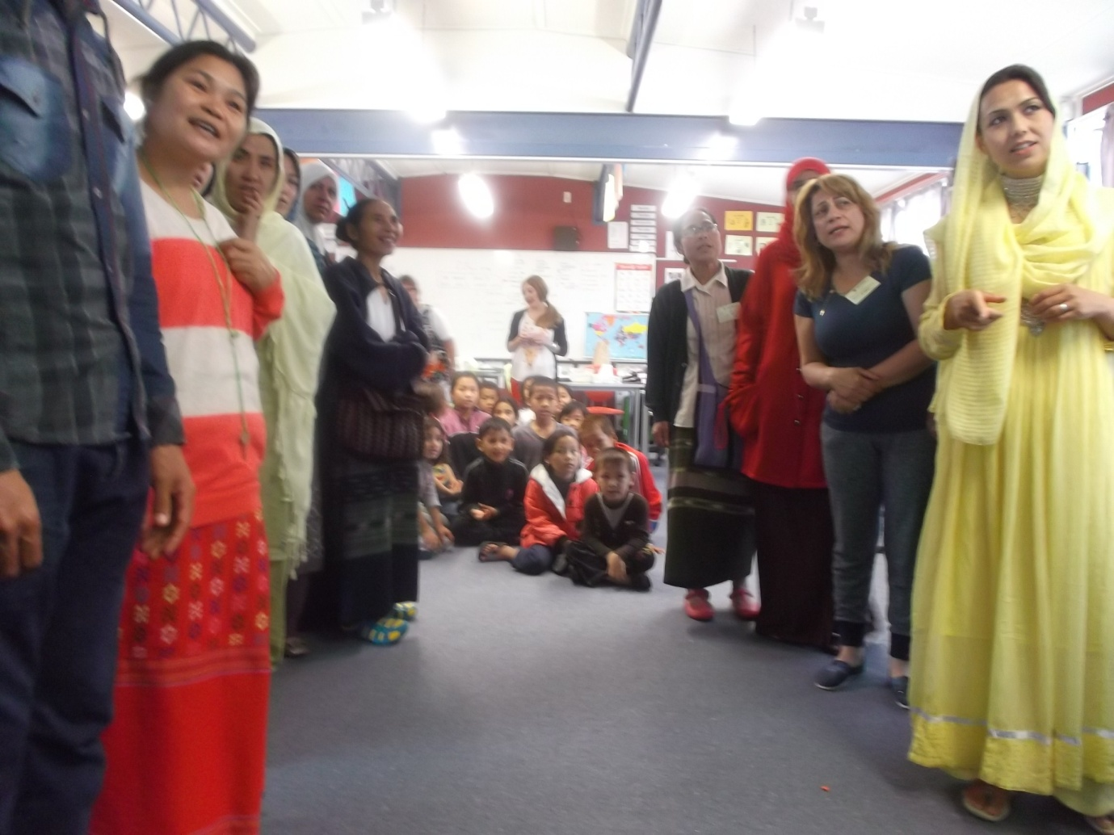
Cooperation
To support teaching and learning

Slide 20
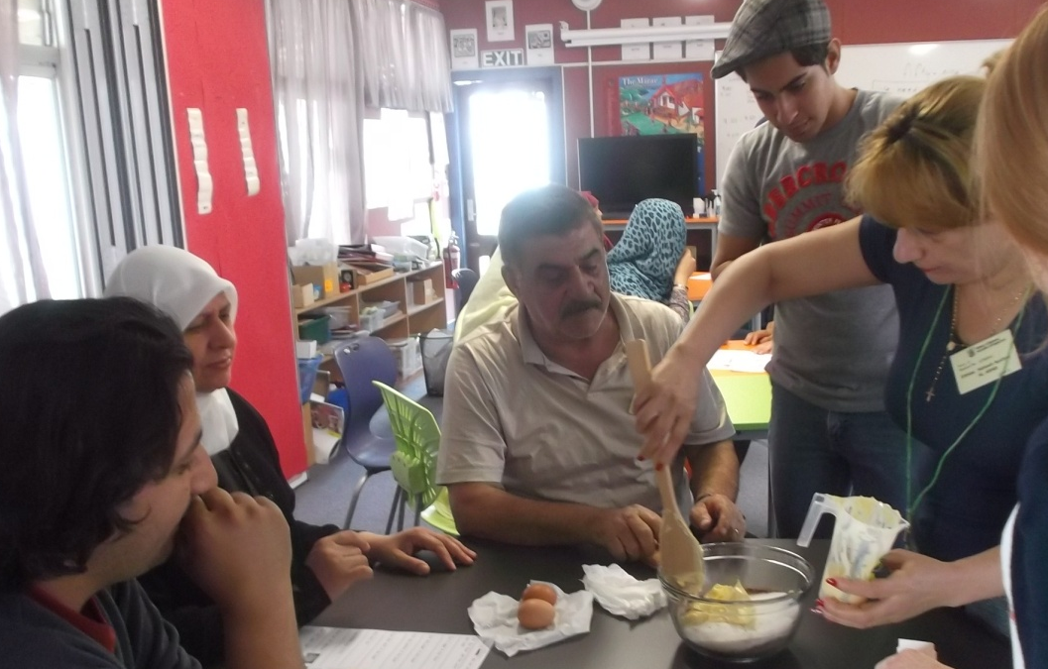
Curiosity in what is observed nearby

Slide 21
Caring in family and community

Slide 22
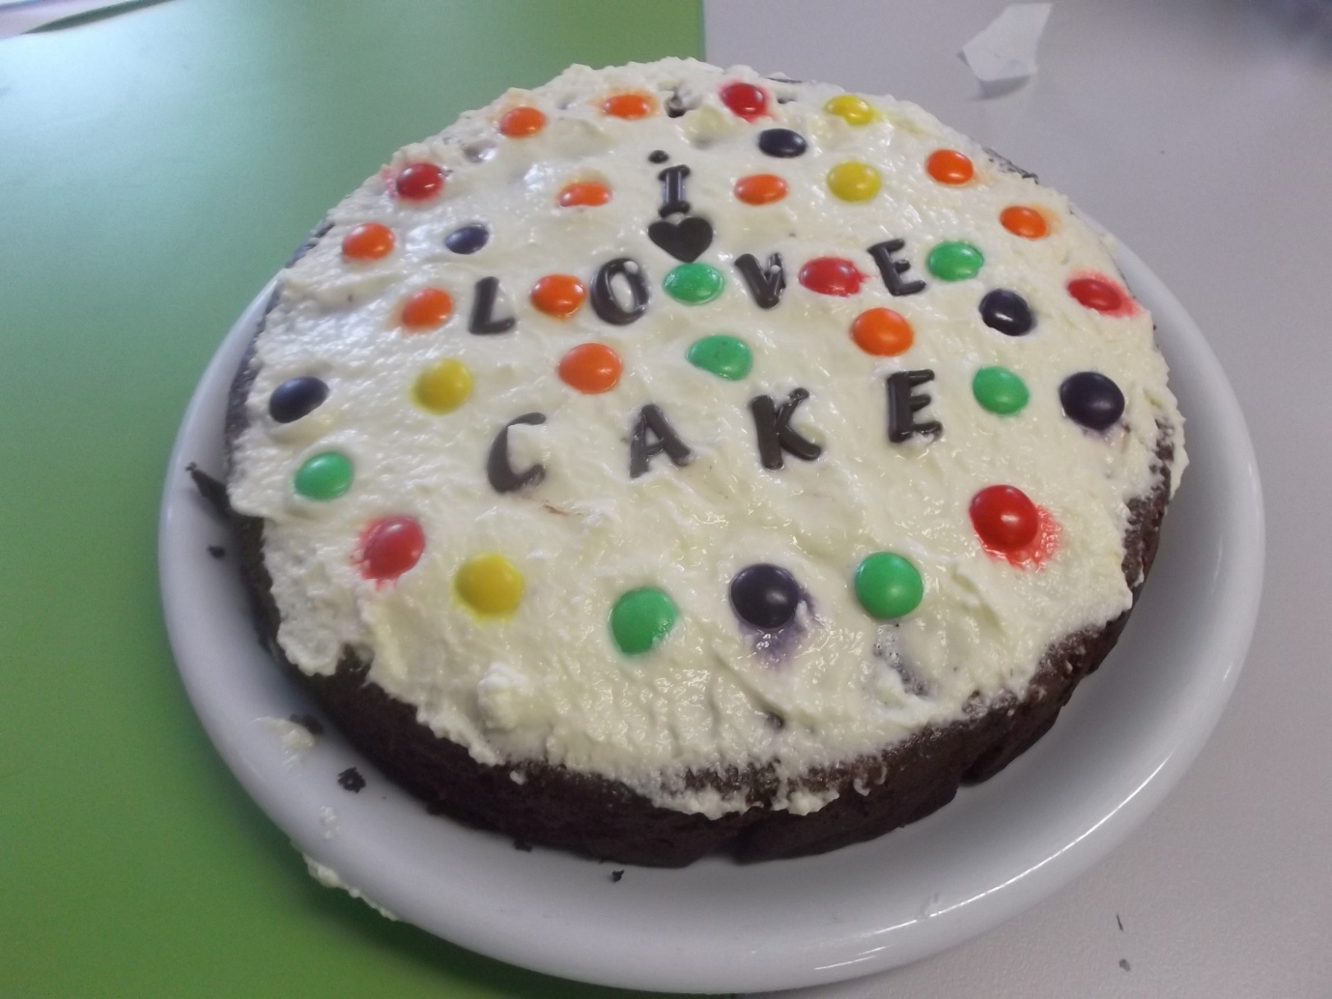
Creativity Created by collaboration

Slide 23
Your Impressions:
Any questions?
What could we have done better?
Your suggestions for future developments

Slide 24
Two heads are better than one
Two heads are better than one- That's a saying that's oh so true Two heads are better than one- There-me! There-you! That's two!
And between the two of you, you can solve Any problem that comes up It's much better to be two, 'Cause what you don't know or can't figure out You can try, too!
Two heads are better than one The more the merrier, you bet Two heads are better than one You could use all the help you can get!
And when all's said and done This is where it's at What I'm simply saying is that Two heads are better than one!
So just put your heads together Yes, put your heads together Quick, put your heads together And have fun! Have fun!
Lyrics: Metro Lyrics
Notes:
Two Heads Are Better Than One Lyrics. (n.d.). Retrieved October 29, 2015, from http://www.metrolyrics.com/two-heads-are-better-than-one-lyrics-sesame-street.html

Slide 25
References
Benseman, J. (2012). Adult refugee learners with limited literacy: needs and effective responses. Refuge, 30(1), 93-103. Retrieved from http://www.yorku.ca/refuge
McCormack, D. (2015, July 16). Do we need more university degrees? Straight-A students can’t ignore the C-skills. The New Zealand Herald, p. A28.
Montiel-Overall, P. (2005). Toward a Theory of Collaboration for Teachers and Librarians. Retrieved from http://files.eric.ed.gov/fulltext/EJ965627.pdf
Proctor Dalton Grisham (2004). Scaffolding English language learners and struggling readers in a universal literacy environment with embedded strategy instruction and vocabulary support. Journal of Literacy Research, 39(1), 71-93. doi:10.1080/10862960709336758
Steeg, S. M., Costley, K., Engelman, K., Gonzalez, D., Knutson, V., & Maroni, K. (2013). Changing teachers, changing students: Exploring iPads in inquiry-based learning. Research in the Schools, 20(2), 57-72. Retrieved from http://www.msera.org/://www.msera.org/http://www.msera.org/
Two Heads Are Better Than One Lyrics. (n.d.). Retrieved October 29, 2015, from http://www.metrolyrics.com/two-heads-are-better-than-one-lyrics-sesame-street.html
Notes:
Benseman, J. (2012). Adult refugee learners with limited literacy: needs and effective responses. Refuge, 30 (1), 93-103. Retrieved from http://www.yorku.ca/refuge
McCormack, D. (2015, July 16). Do we need more university degrees? Straight-A students can’t ignore the C-skills. The New Zealand Herald, p. A28.
Ministry of Education. (n.d.). Innovative Learning Environments: What is an Innovative Learning Environment? Retrieved October 29, 2015, from http://mle.education.govt.nz/
Montiel-Overall, P. (2005). Toward a Theory of Collaboration for Teachers and Librarians. Retrieved from http://files.eric.ed.gov/fulltext/EJ965627.pdf
Proctor Dalton Grisham (2004). Scaffolding English language learners and struggling readers in a universal literacy environment with embedded strategy instruction and vocabulary support. Journal of Literacy Research, 39 (1), 71-93. doi:10.1080/10862960709336758
Steeg, S. M., Costley, K., Engelman, K., Gonzalez, D., Knutson, V., & Maroni, K. (2013). Changing teachers, changing students: Exploring iPads in inquiry-based learning. Research in the Schools, 20(2), 57-72. Retrieved from http://www.msera.org/
Two Heads Are Better Than One Lyrics. (n.d.). Retrieved October 29, 2015, from http://www.metrolyrics.com/two-heads-are-better-than-one-lyrics-sesame-street.html

